Slide 1
Theme 3: National M&E systems and data availability Building on progress made and addressing existing (capacity) gaps
Carlos Barahona
Statistical Services Centre
University of Reading

Slide 2
Presenters
Ahmad Zaki Ansore made a presentation where he shared with us the history and pathways of how Malaysia has developed a sophisticated system for Output to Outcome budget, describing the transition from output based to outcome based, the three essential elements: Players, Tools and Framework and linking the Evaluation of the 11th Malaysia Plan 2016-2020 to the SDG2
Jerven Morten made a provocative presentation forcing us to think about the reliability of data, statistics and indicators generated in many contexts. An eye opener to discuss existing capacity and capacity building needs.
Pietro Gennari presented some of the work done with international organisations, governments and other partners in relation to modernisation of food & agriculture statistics in support of SDG2, an assessment of the current status of Ag Statistics, and some of the FAO initiatives to strengthen SDG2 monitoring including: Food Insecurity Experience Scale (FIES) and Agricultural and Rural Integrated Survey (AGRIS)

Slide 3
Counting Crops
Calogero Carletto, Dean Jolliffe & Raka Banerjee in “From Tragedy to Renaissance:
Improving Agricultural Data for Better Policies” in Morten Jerven and Deborah Johnston (2015) “Statistical Tragedy in Africa? Evaluating the Data Base for African Economic Development”, Special Issue in the Journal of Development Studies.

Slide 4
Counting Crops
Calogero Carletto, Dean Jolliffe & Raka Banerjee in “From Tragedy to Renaissance:
Improving Agricultural Data for Better Policies” in Morten Jerven and Deborah Johnston (2015) “Statistical Tragedy in Africa? Evaluating the Data Base for African Economic Development”, Special Issue in the Journal of Development Studies.

Slide 5
Theme questions
Can we assume that SDG2 is fully aligned with national priorities, policies and strategies?
How well are national M&E systems equipped to track progress on SDG2 and other related SDGs?
What will be critical capacity gaps and data gaps?

Slide 6
What are the challenges and opportunities that IFAD, FAO, WFP and the CG need to be aware of in building partnerships with national governments and other stakeholders?
What should be the priorities of RBA in this interaction?
What capacity is present, what are the most common capacity needs?
Are there any principles for the approach that the meeting would recommend to RBA?
What would be suggested next steps for RBAs in this area?

Slide 7
Can we assume that SDG2 is fully aligned with national priorities, policies and strategies?
Probably not right now…
Variability in the responses from each country is to be expected
SDG are the result of negotiations and agreements between countries and in that respect different in origin from MDGs
Not all the countries agree on the targets. Some targets, are better aligned to national priorities and strategies and other global priority. Hence the level of ownership of these targets (global) can vary at the country level

Slide 8
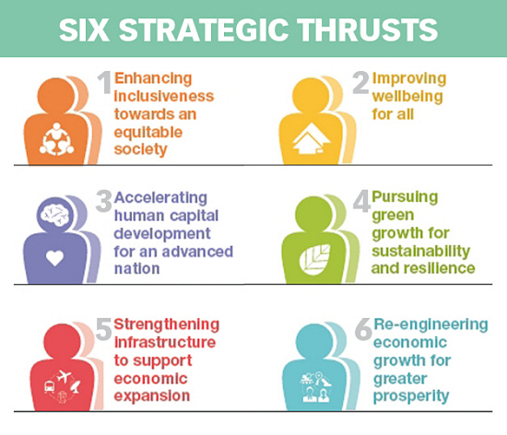
Linking Monitoring and Evaluation (M&E) to SDG2
End hunger
Food Security
Improved nutrition
Sustainable agriculture
PROJECT & POLICY
8

Slide 9
Linking Monitoring and Evaluation (M&E) to SDG2
End hunger
Food Security
Improved nutrition
Sustainable agriculture
PROJECT & POLICY
What we do?
What we aim?
Proof?
Example of Activities
Poverty eradication programs
Fiscal Interventions
Control of Supply Act 1961
Price Standardization Program
Income generation programs
Healthcare & related programs
Education & related programs
Housing & related programs
Agriculture & related programs
Research, Development & Commercialization (RDC) in agriculture
Example of Goals/Outcomes
Raising the income and wealth of B40 households
Addressing the increasing cost of living
Enhancing targeted support for undeserved communities (basic need and infra)
Improving productivity and income of farmers, fishermen & smallholders
Modernizing agriculture
Example of proxy Indicators
Incidence of poverty
Primary school enrolments
Rate of school drop-outs
Consumable income
House ownership
Infant mortality rate
SSL in agriculture
Rate of commercialization
Growth in agriculture sector
9

Slide 10
There is a need for the identification of minimum standards or the set indicators required for meaningful monitoring and afterwards, evaluation.
The SDG outlined 230 indicators which makes it counterproductive for countries to monitor all of them. RBA’s have the opportunity to work with countries to identify what they can do within the SDG 2
This process requires mediation, convincing power, advocacy and facilitation…
……Is this a role for the RBAs?
RBAs should use the potential from the CFS platform to influence and advocate national country level engagement/ endorsement of the SDG targets

Slide 11
How well are national M&E systems equipped to track progress on SDG2 and other related SDGs?
Again high levels of variability in different countries
Monitoring systems are better established than evaluation systems
….the current status of some evaluation systems may offer opportunities to support their development – Evaluation linked to SDG 2 is probably a fertile ground

Slide 12
Credibility of in-country data and statistics
Danger of undermining of capacity at national level
Need of a virtuous circle based on the support of good practices including:
Support for improved methodologies, including but not restricted to, developments in information technology
Development of institutional and individual capacities
Increase credibility – support for the use of quality assurance practices and transparency
Build the demand side of evidence use
Adoption of negotiated agendas between national, intra-national and international partners to be more effective

Slide 13
New Guidelines
The Global Strategy to Improve Agricultural Statistics has developed and published 20 new technical reports/guidelines/handbooks including:
Linking Agricultural and Population Censuses
Methods to develop and use Master Sampling Frames for Agricultural Surveys
Methods for estimating crop area, yield and production under mixed, repeated and continuous cropping
Improved methods for Crop Forecasting
Methods for estimating Cost of Production
Methods for estimating Stocks
Methods for measuring Post-Harvest Losses of specific crops through the entire supply chain
Methods for estimating Livestock production and productivity
Improving the quality and use of data from Administrative sources for agricultural statistics

Slide 14
Quality assurance
Can this be used as an entry point? Allowing
Identification of strengths and weaknesses in data collection, processing and reporting systems
Prioritisation of potential actions and “harvesting of low hanging fruit”
Increase capacity
Reduce burden in the collection of data and generation of information

Slide 15
Behaviour and attitudes
Awareness of
Institutional characteristics that influence the way people within them behave
Perverse incentives but also disincentives to good performance within some government institutions

Slide 16
Work on the demand side of data and evidence
Strengthen capacity on the demand side: the more data and evidence derived from data is demanded, the more likely this will result in incentives to improve data.
Support the collection of data that will lead to indicators, but also the process of reporting and dissemination of the results to increase engagement of stakeholders

Slide 17
Understand the smallholder and its context

Slide 20
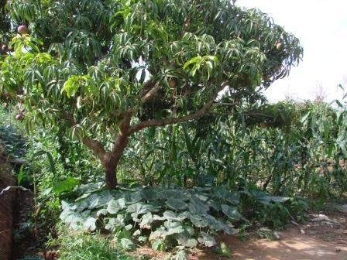

Slide 21
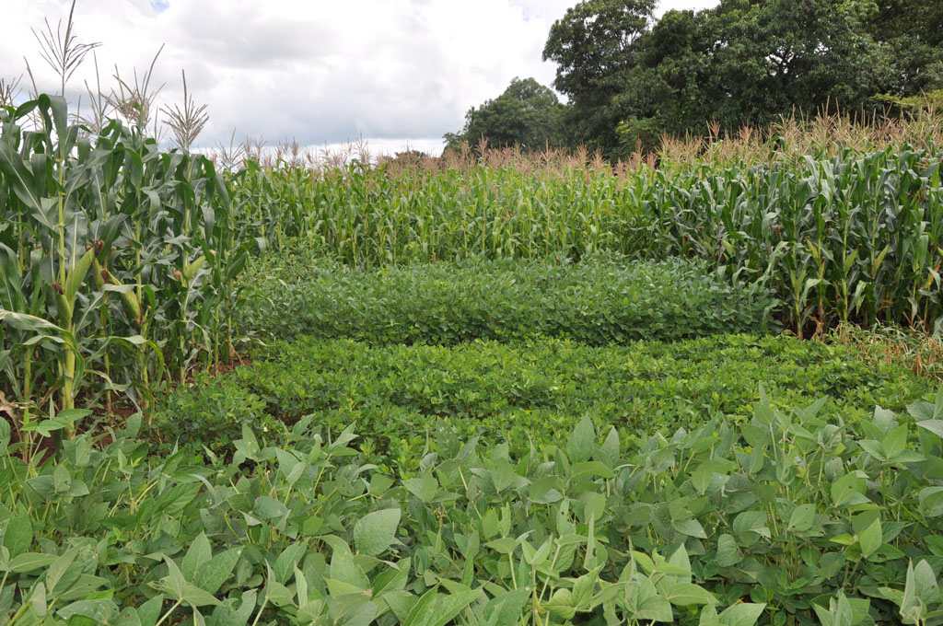

Slide 22
Do not add extra burden: avoid as much as possible imposing extra requirements
Support government agencies to use better the data and statistics available already
Avoid destroying in order to build
Start at a humble level
Continue supporting accumulation of data and metadata for the use in the future
…Let’s work towards making it easy for our partners

