Slide 1
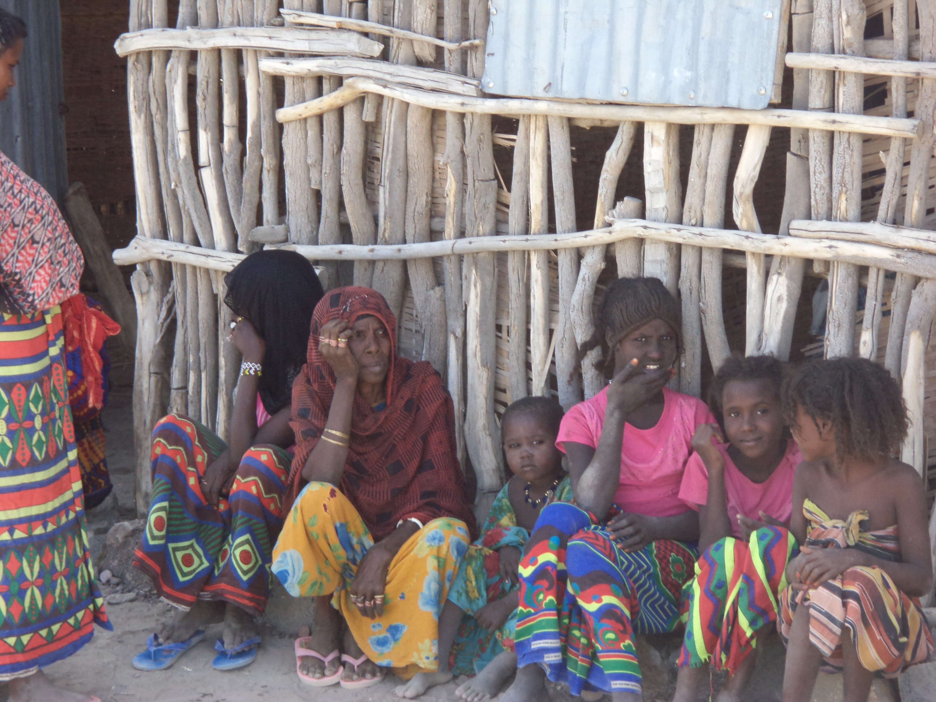
IFAD’s Approach to Evaluation of Agriculture programmes
Presentation at ECD Workshop, Addis Ababa, 6 November 2015

Slide 2
Benefits of monitoring & evaluation
• Determine the extent to which the programme is on track and to make any needed corrections accordingly
• Make informed decisions regarding operations management and service delivery
• Ensure the most effective and efficient use of resources
• Evaluate the extent to which the programme is having or has had the desired effects
Monitoring: tracking the key elements of programme performance on a regular basis (inputs, activities, results). Responsibility: Management
Evaluation: The systematic and objective assessment of an on-going or completed project, programme or policy, its design, implementation and results. Responsibility: either Management or Independent Unit.
2

Slide 3
Independent Evaluation at IFAD
IFAD’s independent Office of Evaluation (IOE)
Special division of IFAD, does not report to IFAD’s management
Reports to the Executive Board of IFAD (representative of member states)
Evaluation Policy 2011
Evaluation Manual 2015
Two main principles: accountability and learning
3

Slide 4
Types of Evaluations
Types of evaluations by IOE
Corporate-level Evaluations
Country Programme Evaluations
Project Evaluations
Evaluation Synthesis Reports
Impact Evaluations
Annual Report on Results and Impact (ARRI)
4

Slide 5
Independent & Self-Evaluation
Self-evaluation | Independent evaluation
Under management oversight Closer to the action Lacks distance, less objective Exposed to vested interests Often lacks evaluation skills Interests and concerns may differ from beneficiaries. Likely to select evidence that supports assumptions | Independence protected by governance structure Challenges assumptions on the design of policies & programs Makes self-evaluators think about achievements, stakeholder consultation, program goals etc. Enhances effectiveness of self-evaluation Validates information
5

Slide 6
IOE’s Evaluation process
Planning and conducting evaluations
Selection of cases & themes
Approach paper
Desk review
Data collection in the field
Debriefing
Draft report & peer review.
Comments by Government & IFAD Management
Feedback to Stakeholders
Management response
Agreement at completion point
Final report
Communication products
6

Slide 7
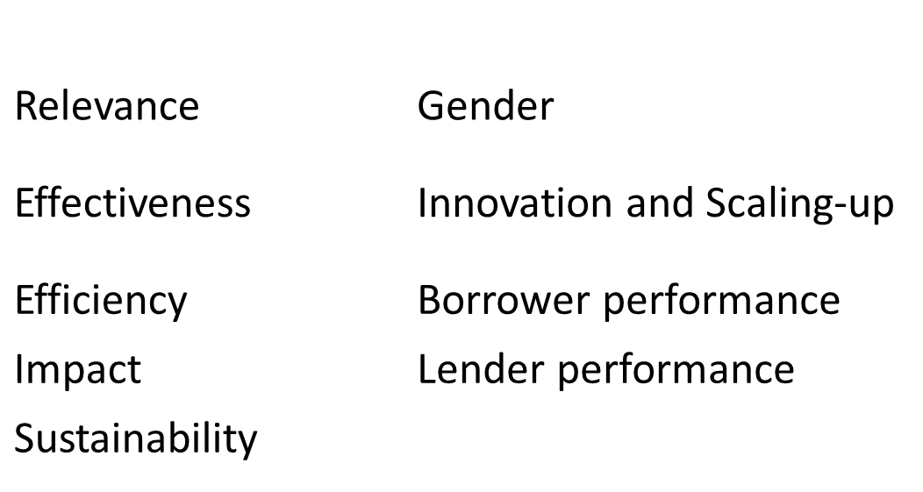
Evaluation Criteria (6 point scale)
7

Slide 8
Selected key principles
Baseline
Counterfactuals
Triangulation
Evidence trail
Answering the WHY question
8

