Slide 1
Federal Democratic Republic of Ethiopia
Country Programme Evaluation (2007-2015)
National Roundtable Workshop
Addis Ababa, 5 November 2015

Slide 2
IFAD-Ethiopia Cooperation highlights
17 programmes approved since 1980, four ongoing
COSOPs: 1999, and 2008
ICO: 2005
CD in country: 2010
Portfolio cost: US$1.2 billion
IFAD: US$ 473 m programme + US$ 28 m debt relief
CPE covers IFAD – Ethiopia partnership 2007-2015, 8 projects, 2008 COSOP and country pgm mgt

Slide 3
Evaluation Objectives/Methodology
Objectives
Assess the results of IFAD-supported operations in Ethiopia
Generate findings and recommendations to enhance the country programme effectiveness and inform the preparation of the next Ethiopia COSOP
Methodology
CPE assesses: (i) project portfolio performance; (ii) non-lending activities (Knowledge management, Partnerships; Policy dialogue); (iii) performance of the 2008 COSOP
A variety of data collection methods used and triangulation

Slide 4
Evaluation Process
Inception Phase – preparatory mission and approach paper, Nov 2014
Desk review Oct 2014 – Jan 2015
Main mission in Ethiopia, multi-disciplinary team visited all current projects, Feb-Mar 2015
Report preparation analysis, writing, peer review, Govt. and IFAD comments, Apr - Oct 2015
CPE NRTW 5 Nov 2015
Agreement at Completion Point (GOE-IFAD)

Slide 5
Projects covered by the CPE
Rural Finance Intermediation Programme (RUFIP) I: 2001-10 (89 $m), II: 2011-19 (248 $m)
Pastoral Community Development Project (PCDP) I : 2003-09 (60 $m), II: 2009-15 (139 $m) and III: 2013-21 (210 $m)
Agriculture Marketing Improvement Programme (AMIP): 2006-13 (28 $m)
Participatory Small-scale Irrigation Development Programme (PASIDP): 2007-15 (58 $m)
Community-Based Integrated Natural Resources Management Project (CBINReMP): 2009-17 (27 $m)

Slide 6
IFAD supported operations

Slide 7
Country Strategy
3 Strategic Objectives: Enhanced access of poor HH to
1) natural resources;
2) agricultural production technologies and support services;
3) financial services
Community Based approaches
Smallholders, agro-pastoralists, pastoralists and landless
Youth and women
Policy development

Slide 8
Main Findings (1): general
IFAD is an effective donor in the rural sector in Ethiopia, strong partnership with GOE and liaison with donors
Good use of GOE structures and anchorage
Relevant focus on selected areas of crucial importance in all 3 agro-ecological areas (highlands: moist, drought-prone, dry lowlands)
Overall satisfactory programme

Slide 9
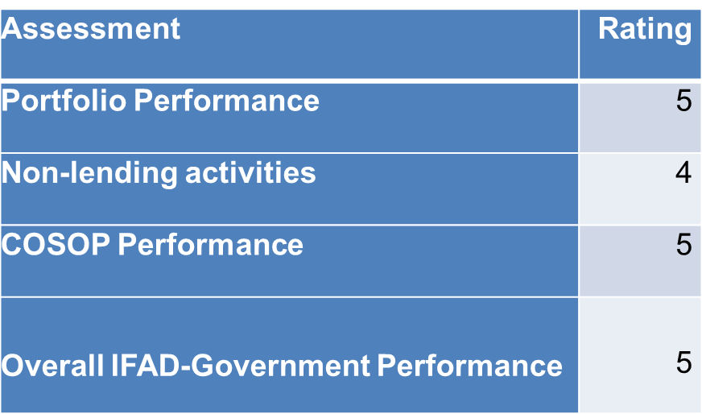
Main findings (2)

Slide 10
Main Findings: Project Portfolio (1)
Overall project portfolio achievement was satisfactory for all projects, with the exception of agriculture marketing and ph 1 pastoral dev
Participatory and community approaches
Very relevant portfolio
Gender: appropriate emphasis across the portfolio; capacity building, economic empowerment

Slide 11
Main Findings: Project Portfolio (2)
Performance of projects was moderately satisfactory: effectiveness and efficiency were moderately satisfactory while relevance was satisfactory
Efficiency was affected by implementation delays and lack of evidence on costs vs benefits
Complex designs (irrigation, NRM)
Improvements required (rural finance, pastoral development)

Slide 12
Main Findings: Non-lending
Overall moderately satisfactory
Policy dialogue: IFAD’s role is not in “setting Government policy agenda” but in using project experience to support policy processes
Very few issues foreseen in COSOP were adressed and policy efforts were not substantiated. IFAD is well respected and some advice succesfully took place
Shortcomings in M&E which is required to feed KM; lack of clear and actionable agenda for KM

Slide 13
Main Findings: Country strategy
Objectives were largely relevant
Strong focus on rural poverty alleviation
Majority of COSOP indicators are likely to be met
COSOP Results Framework not used as a management tool to monitor and steer the programme. Lack of clarity on outputs and outcomes and logical causality chain

Slide 14
Main Findings: Programme Mgt
Active presence in country since 2010, trusted by GOE
Self evaluation and coverage of programme progress: superficial
Overstretched ICO
Despite challenges satisfactory management overall

Slide 15
Conclusions (1)
Relevant focus on selected areas of crucial importance for rural poverty alleviation
In two of these - small-scale irrigation and rural finance - IFAD lead or major development partner + with WB, substantial partner for development of pastoral communities
Community participation: bottom up approach, downward accountability, effectiveness of development support, support GOE effort in decentralisation.

Slide 16
Conclusions (2)
IFAD effective donor in the rural sector in Ethiopia, strong partnership with GOE and donors
IFAD’s country presence appreciated by GOE and credited with effective support
GOE effective partner ensuring that IFAD (and other donor) programmes are fully aligned to its priorities and needs
Solid and satisfactory programme overall

Slide 17
Main recommendations
Focus on fewer thematic areas and enhance the quality of programmes
SSI; rural finance; pastoral development
Enhance strategic partnerships: attract partners and collaborate (eg. to adress marketing constraints PASIDP)
Mainstream climate change and sustainable land and water management (use CBINReMP/SLMP experience)
Pastoralists should be able to choose their livelihoods; the design interventions need to also adress mobility (PCDP)
Mobilising funding for rural finance (RUFIP)

Slide 18
Main recommendations
2. Use longer-term programmatic approach to lending
PCDP as a good example of 15-20 years orientation with succesive phases, ensuring continuity, learning, adressing gaps and improving impact
Clearer focus on non-lending services
Project-based lessons in knowledge products to underpin discussions and engagement with GOE and development partners in view of greater performance and impact on poverty

