Slide 1
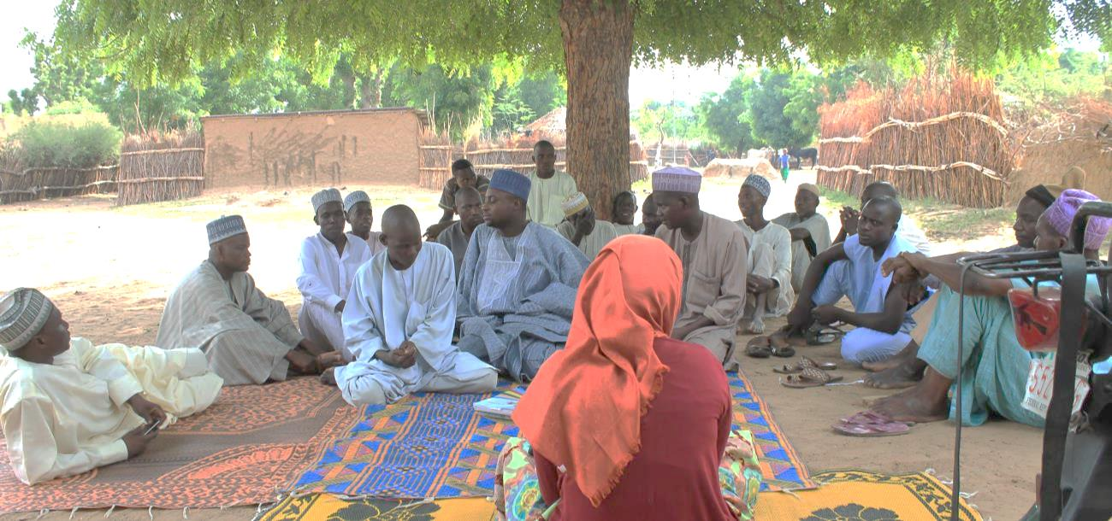
The Independent Office of Evaluation of IFAD
Country Programme Evaluation Nigeria
National Roundtable Workshop, Abuja, 7 April 2016

Slide 2
Country Programme Evaluation (CPE)
CPE Objectives
  Assess the results and performance of the IFAD-Government partnership to reduce rural poverty: and to
  Generate findings and recommendations for the future partnership between IFAD and the concerned country.
Aligned with IFAD’s strategic cycle – 2nd Country Strategic Opportunities Programme (2010-2015)
CPE findings and recommendations to inform the preparation of the 3rd COSOP in 2016.
Agreement at Completion Point, to be signed by IFAD and Federal Ministry of Finance
2

Slide 3
IFAD Nigeria Overview
IFAD in Nigeria since1985
10 loans approved
Total Portfolio cost: US$ 795.3 million
Total IFAD lending: US$ 317.9 million
Country presence (2005); CPM out-posted (2012)
1st COSOP from 2001-2009
2nd COSOP: 2010 – 2015; two strategic objectives:
  (1) to address underlying causes of rural poverty (production, processing, marketing, finance);
  (2) to strengthen government and community capacity to address those causes.

Slide 4
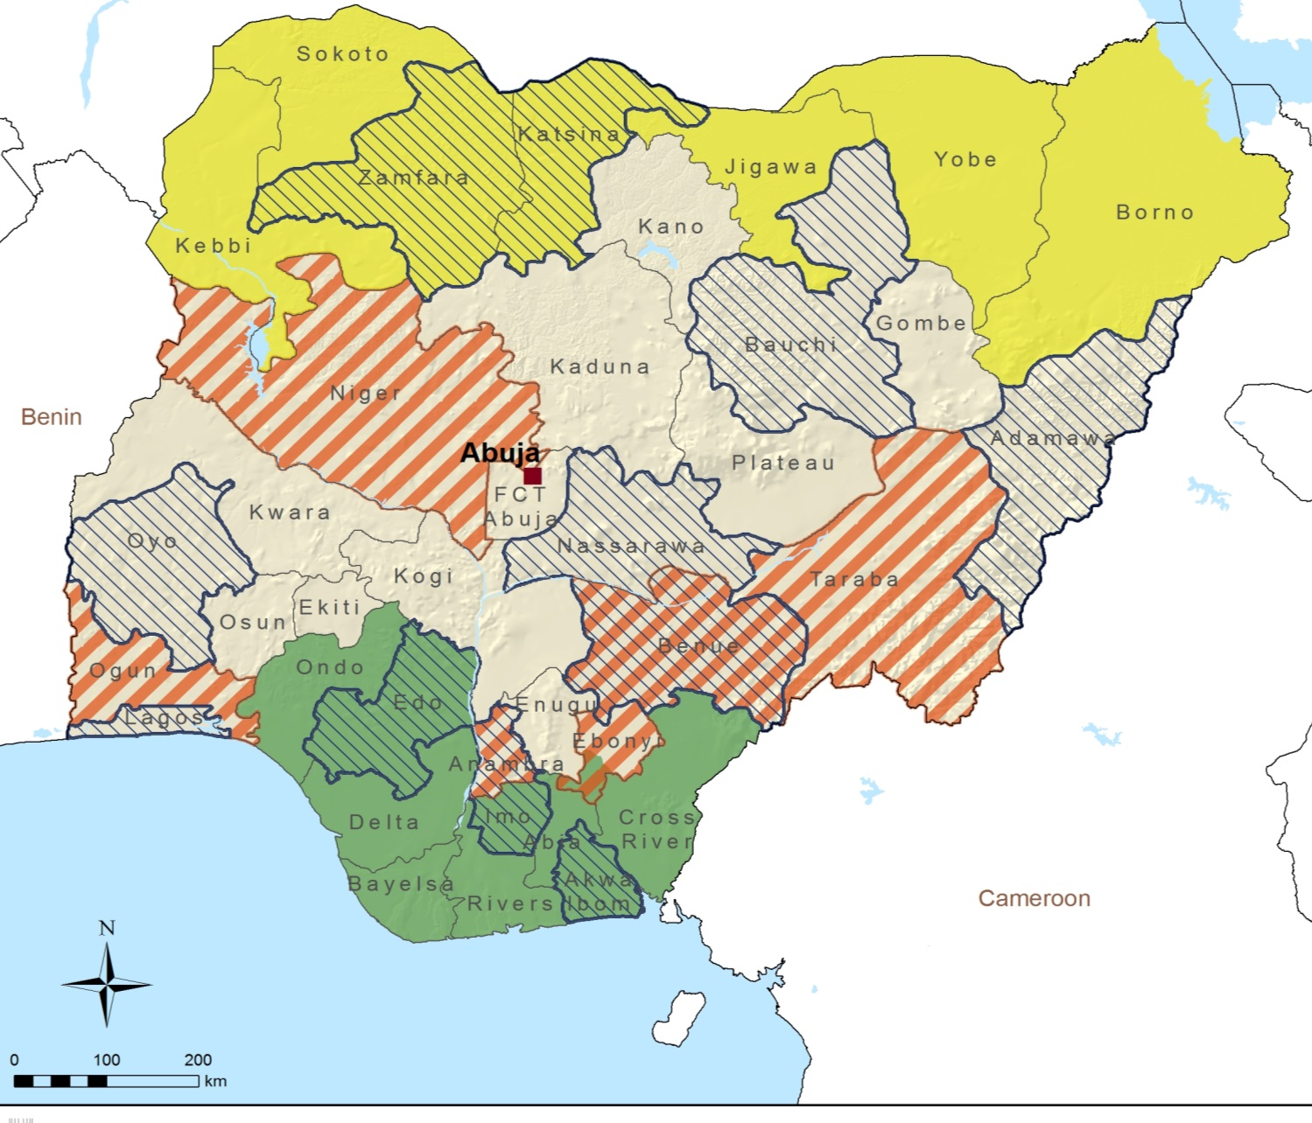
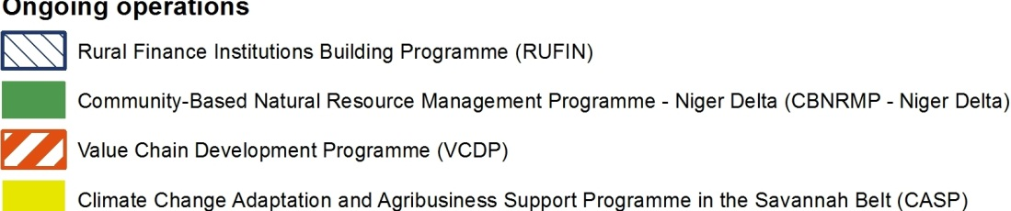
IFAD ongoing portfolio

Slide 5
CPE Scope (2009 – 2015)
Lending portfolio
  Community-Based Natural Resource Management Programme (CBNRMP), US$15 million
  Rural Finance Institution Building Programme (RUFIN), US$27.6 million
  Value Chain Development Programme (VCDP), US$74.5 million
  Climate Change Adaptation and Agribusiness Support Programme (CASP), effective since 2015, US$88.5m
  Completed projects (CBARDP, RTEP)
Grants portfolio: 5 loan component grants, 2 country-specific grants, 15 regional grants (total: US$ 26 million)
Policy dialogue, knowledge management, Partnership building

Slide 6
CPE Process
Project performance of CBARDP (May-June 2015),
  Included visits to project sites in 4 Northern States (Kebbi, Sokoto, Katsina and Jigawa)
CPE preparatory mission in July 2015
Desk work phase: Project documents review; analysis of NBS data, financial data and project M&E data
CPE main mission (September 2015)
  Visits to project sites in 9 States (Oyo, Lagos, Edo, Rivers, Abia, Cross Rivers, Benue, Nasarawa and Niger)
  Stakeholder meetings in Abuja, Ibadan, Lagos, Abia, Port Harcourt
Draft report sent to Government and IFAD programme management for comments (January 2016)

Slide 7
Country Strategic Opportunities
Programme (Evaluation Findings

Slide 8
Strategic shift towards agriculture
Strategic shift towards agriculture under 2nd COSOP
Better policy alignment: Government policies and strategies (Vision 20:2020, ATA) and IFAD’s core business (smallholder agriculture)
Move away from integrated community development programmes with broad social and economic investments to market-led, commodity-based value chains and rural finance
But, IFAD’s programmes have long timespans; strategic shift led to multiple design adjustments over programme lifetime (‘re-design turbulence’)

Slide 9
Geographic focus and targeting
Greater focus of IFAD support on the poorest regions of the North
Geographic targeting difficult (within states and within LGs), lacks reliable poverty data
Interventions geographically spread out and scattered through 27 States (~90 LGs)
Broad multi-region coverage created gaps and prevented overlaps & synergies

Slide 10
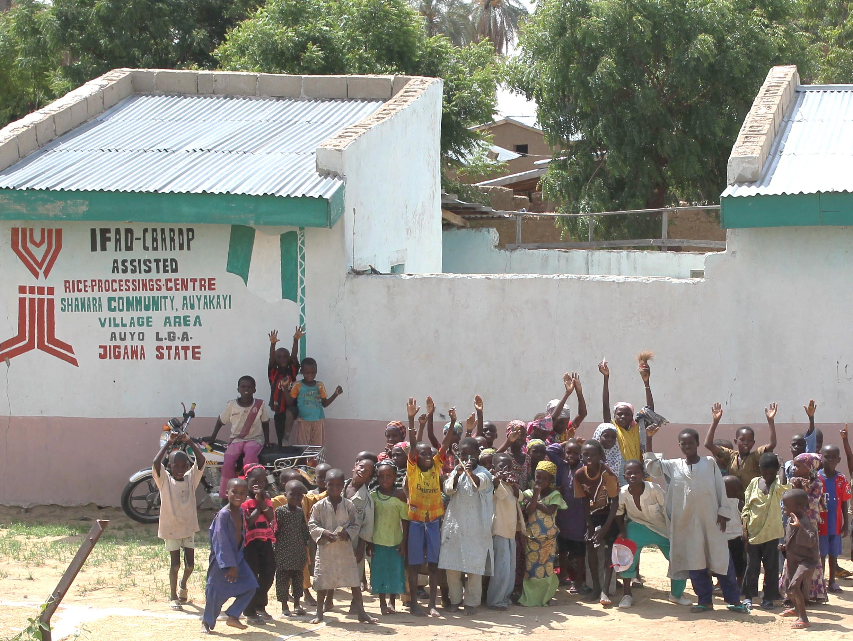
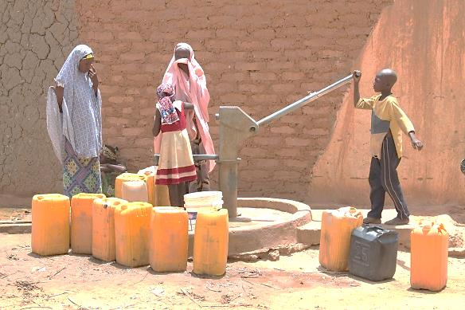
Islands of results
IFAD-supported programmes reached 9.2 million beneficiaries out of the 14.2 million targeted
Beneficiary outreach was less than planned
Concentrated investments in a limited number of villages
Good targeting within communities (incl. women & youth)
Benefits: Asset creation, access to financial services, community capacity building and job creation
But, impact limited given the scale of the country and poverty depth
Notes:
e.g. CBARDP: 207 selected village areas, 28,116 investments into community infrastructure, sustainable agricultural development, rural enterprise and financial linkages support and gender and vulnerable group development

Slide 11
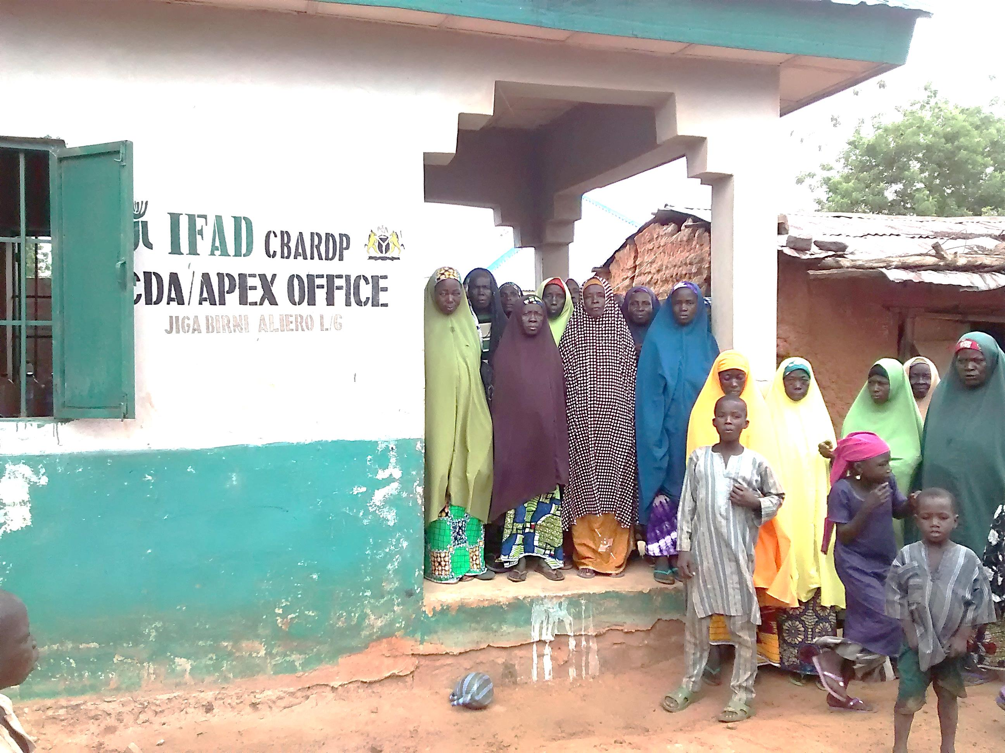
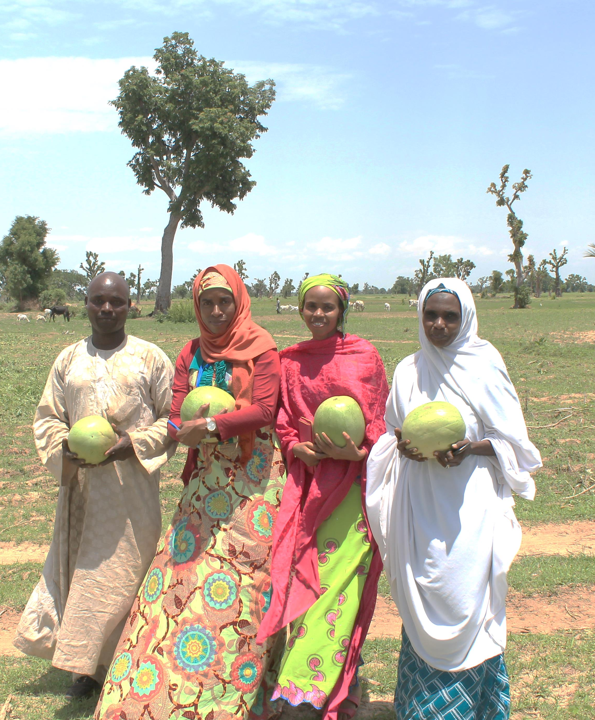
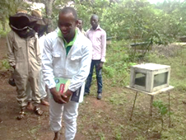
Community-level poverty reduction
IFAD’s comparative advantage: tackling poverty and deprivation at community level through building community assets and capacities
Most significant impact: Community Development Associations (CDAs) as a 4th tier of government in the North; Commodity apex development associations (CADAs)
Good sustainability of CDAs in the North; state governments continue to fund; State legislation and funding have been introduced in Sokoto, Kebbi and Katsina States

Slide 12
Efficiency is a mixed story
Average start-up delay 26 months (2x IFAD average)
State government commitments low or lagging; frequent political changes
Geographic stretch with large number of states and LGAs led to high management overheads (≥ 20%); CDD programmes almost 30%
But, CDD programmes had good allocative efficiency and better cost efficiency

Slide 13
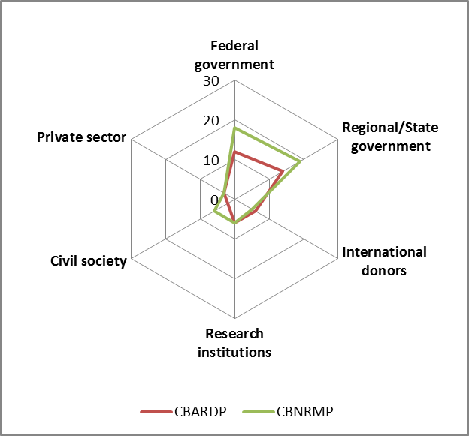
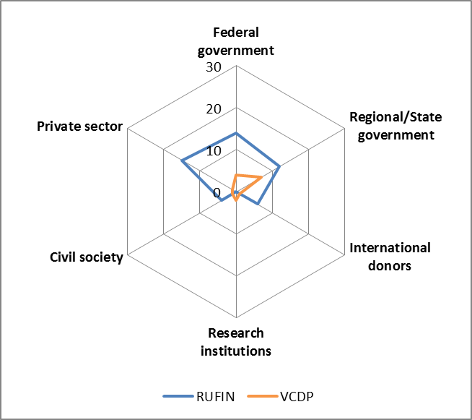
Policy engagement
Country office created cost-efficient opportunities for policy dialogue; through sector working group, grants and the platform created by RUFIN
Partnerships were somewhat opportunistic and ad hoc; mainly within programmes
Absence of a well-structure policy coordination unit within FMARD limited policy influence and coherence
Increased attention to knowledge management, but limited evidence from the field (poor M&E)

Slide 14
Conclusions and recommendations

Slide 15
Conclusions
Good results were achieved through strong commitment at local (state and community) level.
Efficiency is a bottleneck affecting achievement of results (late start-ups, high management overheads)
Overall impact very limited, given the size of the country and the depth of poverty (“islands of results”)
Many factors contributing to successful engagement at local level; more difficult to address in larger programmes
Scaling up of results and impact will require improved systems for coordination, knowledge management and M&E at federal level

Slide 16
Recommendations
Address issues of state commitment through increased geographic focus, transformed state-level partnerships and realistic levels of counterpart funding
Increase leverage and presence in operations e.g. through linking loans and grants, supervision, capacity for state engagement, high-level policy engagement
Dedicate resources to important crosscutting issues, incl. conflict, pastoralism, youth and gender.
Expand existing and develop new partnerships particularly outside of government
Build on IFAD’s knowledge management strategy by improving the quality of evidence from the field

Slide 17
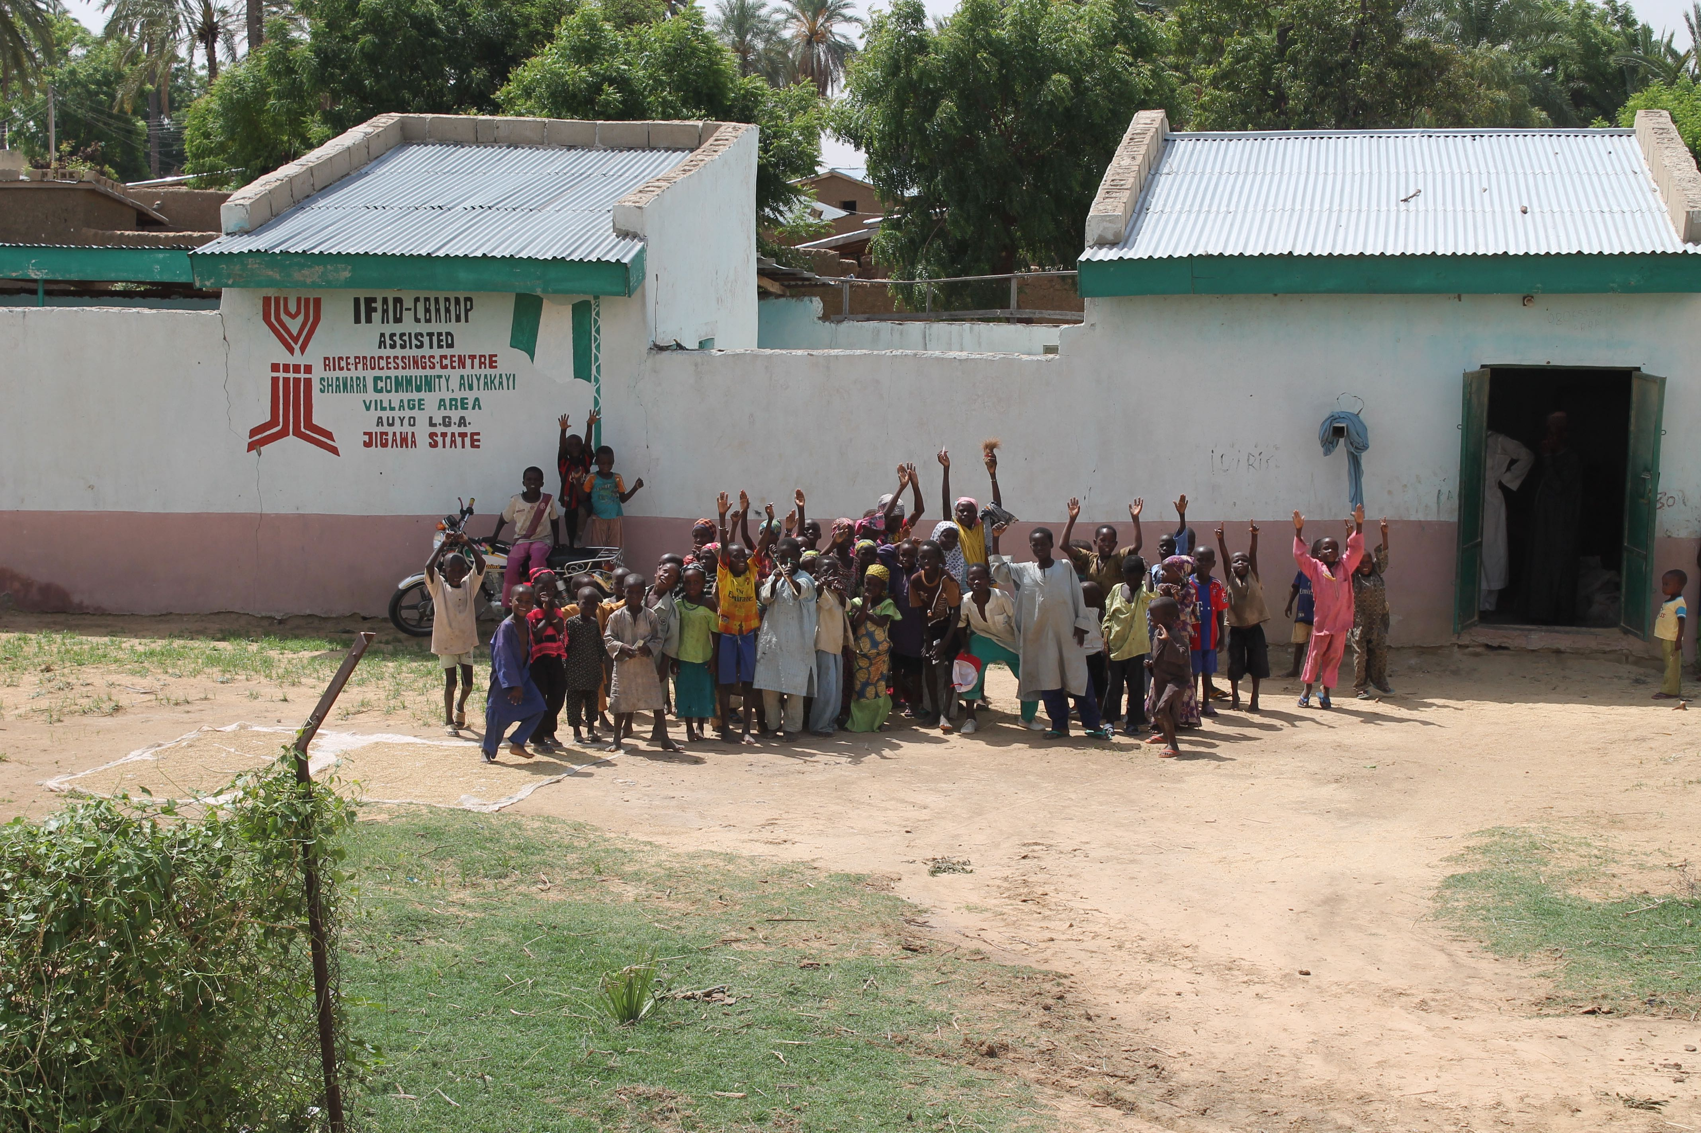
Thank you!

