Slide 1
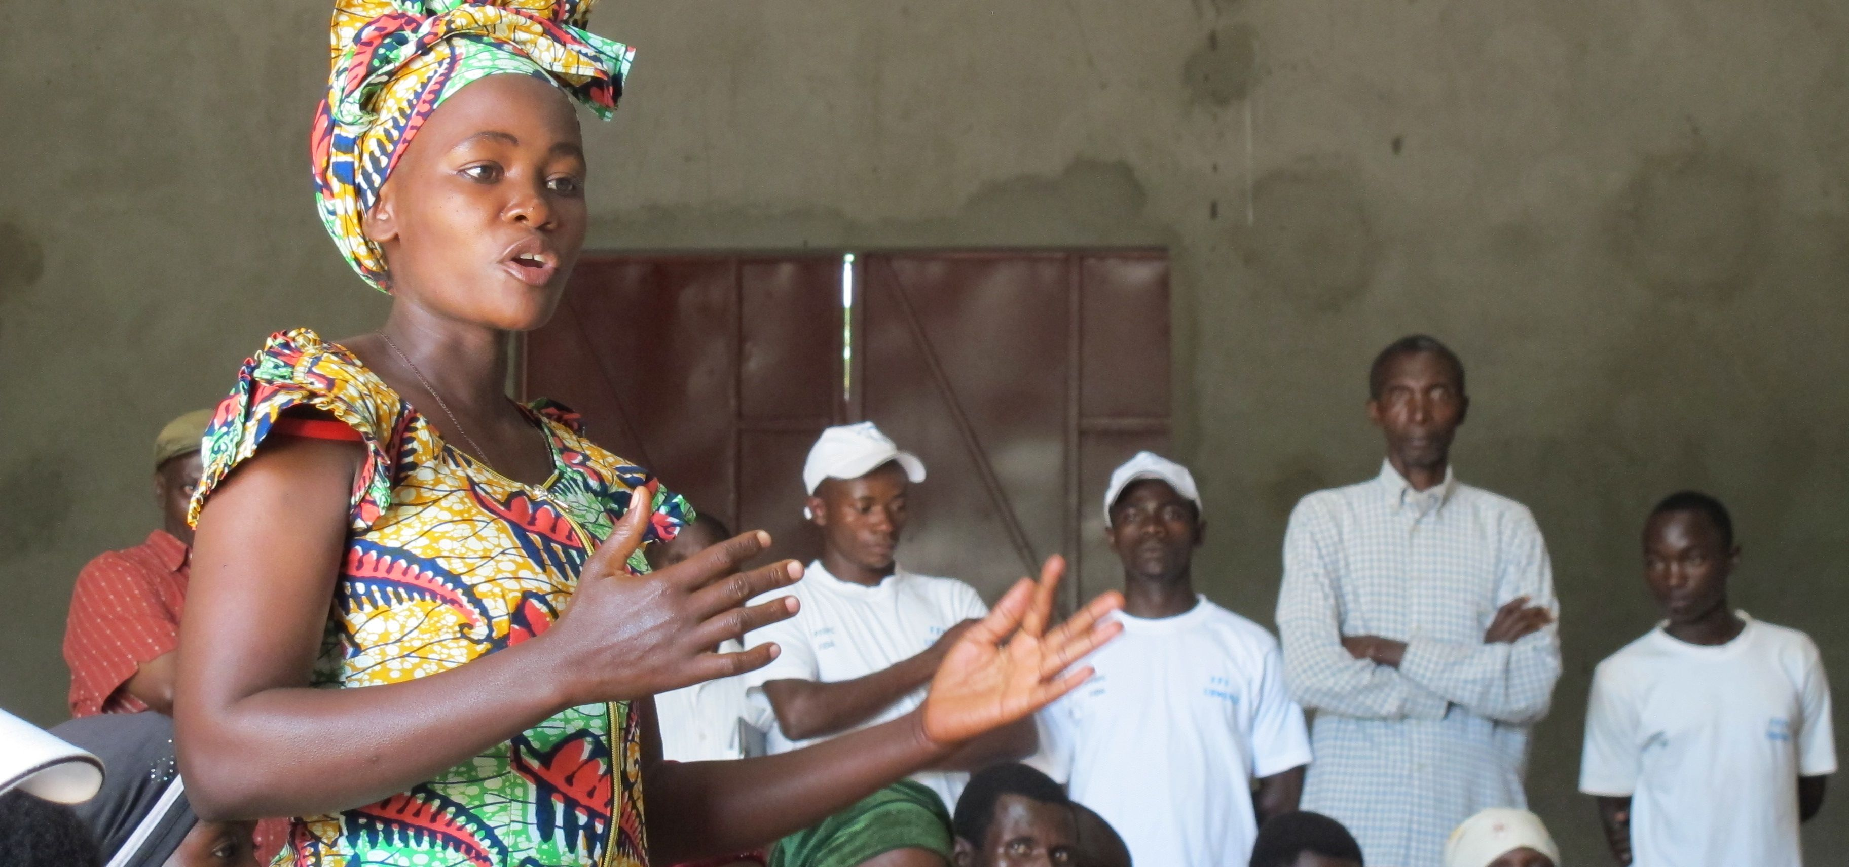
Towards a GEWE Theory of Change
Framework developed for the Evaluation Synthesis on GEWE practices

Slide 2
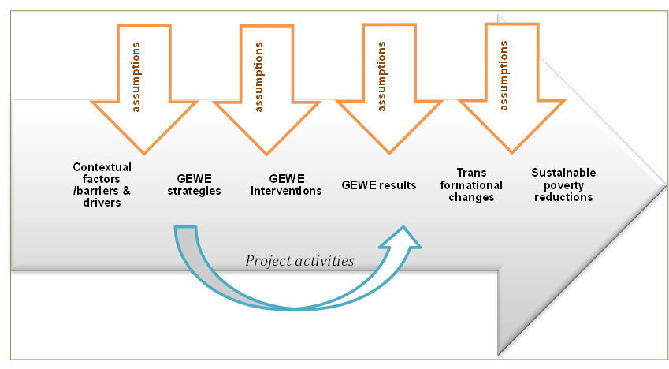
Generic GEWE Pathway ToC

Slide 3
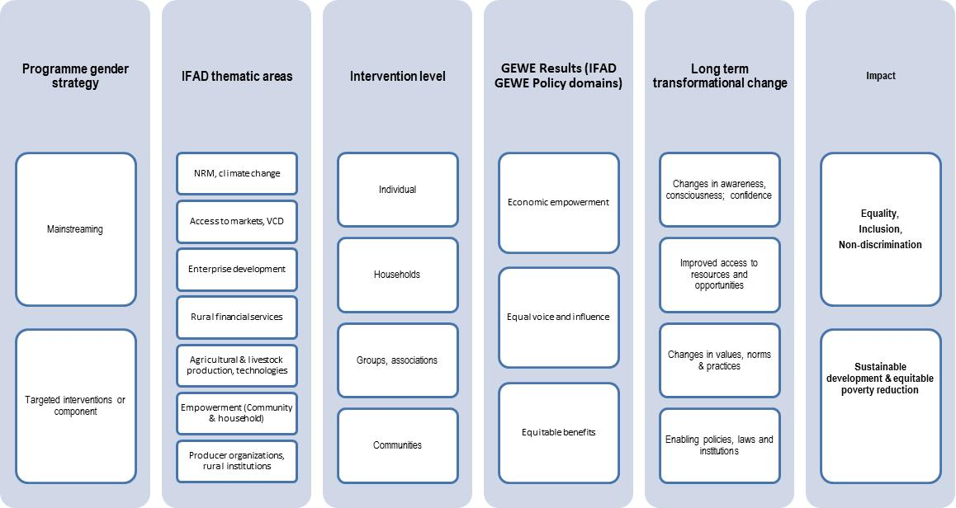
GEWE interventions and results

Slide 4
Bangladesh: Microfinance for Marginal and Small Farmers Project
Other activities: livestock insurance pilot, crop storage loans, mkt linkage support…
Favourable weather
Increased production for home consumption, reduced need to buy food
Project components
Training of members in social issues
Technology adoption
Group mobilization, training of SMFs in crop/livestock production technologies
Increased returns to agricultural production (yield↑ and/or cost↓)
Capacity- building and other support to POs, DAE
Increased marketed outputs
Access to input markets
Access to output markets
Improved provision of microfinance services by MFIs
Availability of funding
Services better suited to the needs of SMFs
Credit funds to POs for on-lending to SMFs
Effective use of microcredit for productive purposes
Off-farm enterprise activities
Increased access to microfinance services by SMFs
Increased incomes, improved food security
Demand, uptake
SMFs: Small and marginal farmers
MFIs: Microfinance Institutions
DAE: Dept of Agric Extension
Savings ↑
Vulnerability to shocks ↓
Notes:
Purple are assumptions

Slide 5
Questions for this workshop
How can GEWE practices be linked to outcomes and longer term changes and impact? What evidence and knowledge do we have about those links?
What are the key assumptions and factors that enable or hinder GEWE results and long term transformative changes?
Where are the gaps in terms of focus and knowledge?

