Slide 1
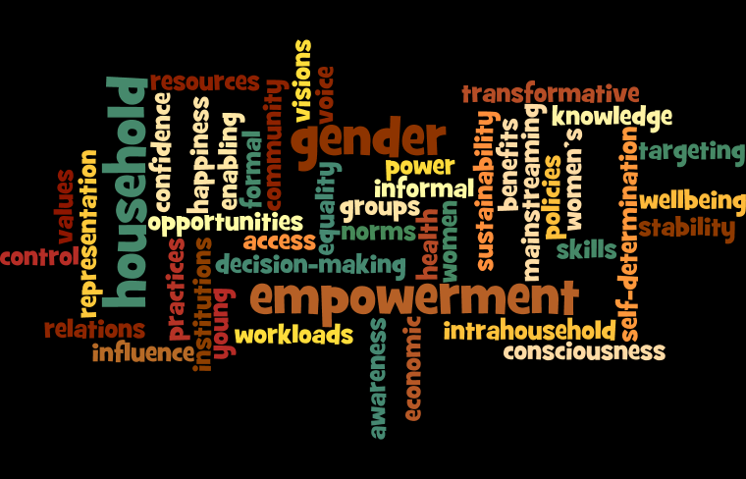

Slide 2
Rural women: gender inequalities
Access and control over resources:
human, natural, physical, financial, social
Workloads:
gender division of labour, household/ productive tasks, multitasking, length of working day
Well-being:
health, freedom from domestic violence, mobility
Gender roles and relations
Inter-generational issues
Cultural norms + practices
Access and control
over benefits:
monetary, non-monetary, food and nutrition security
Decision-making:
household, group, community
Implications for motivation, productivity, sustainability

Slide 3
Gender scores in loan portfolio
90% 50% 15%
Design
Implementation
Completion

Slide 4
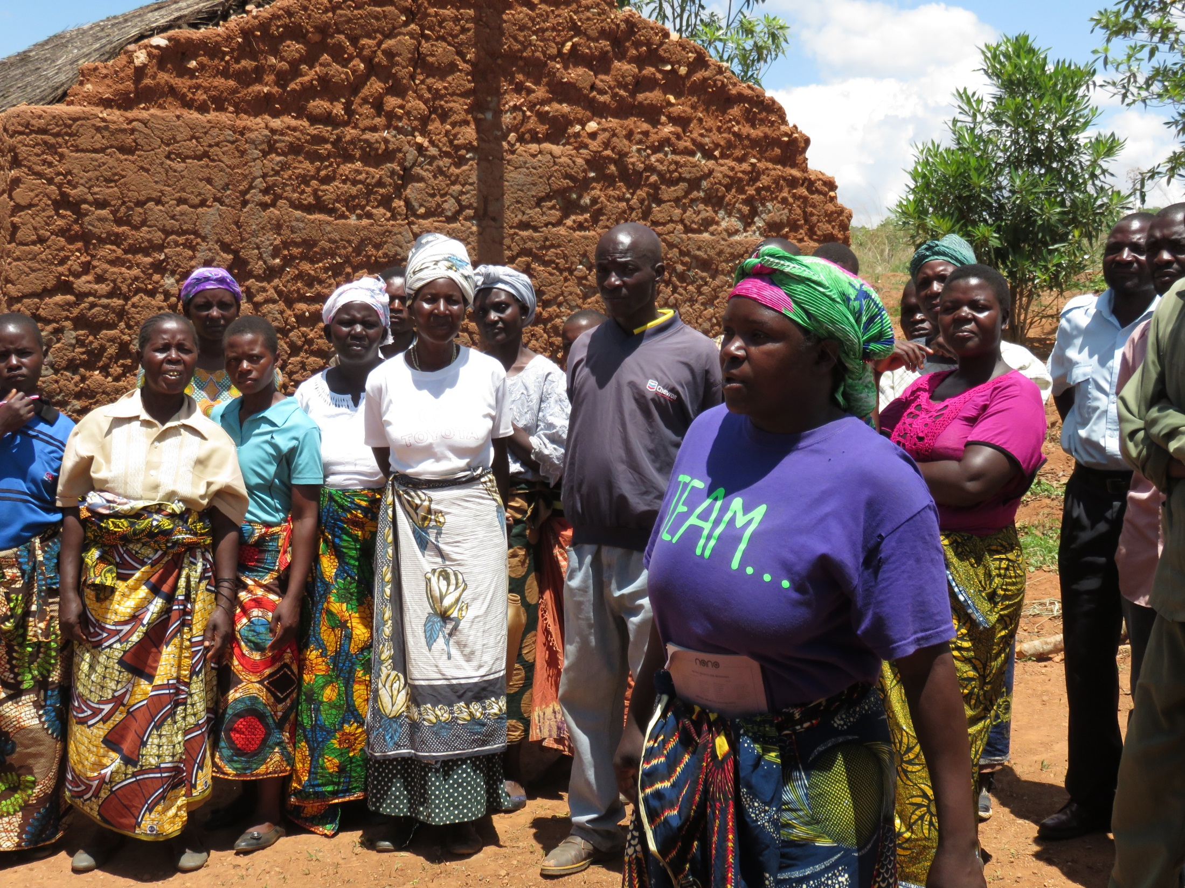
Power …..
… to
… with
… within
… over

