Slide 1
Country Strategy and Programme Evaluation - Philippines
Main evaluation findings and recommendations
National Workshop, Manila, 16 November 2016

Slide 2
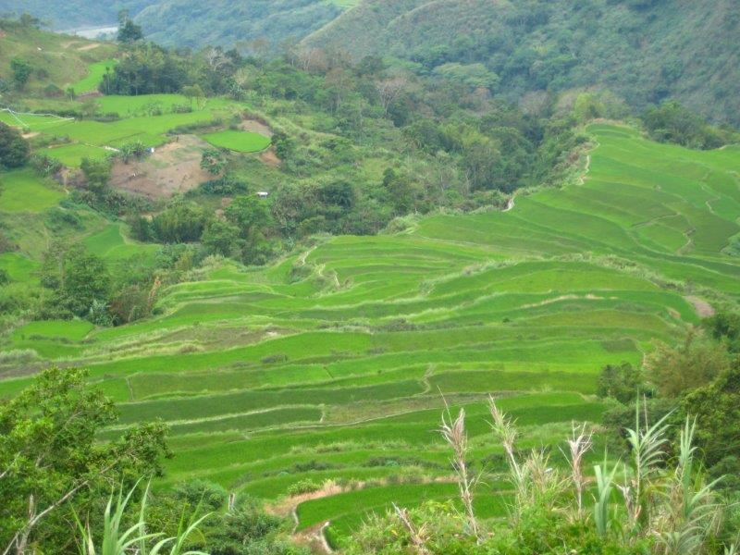
Presentation outline
IFAD in the Philippines - overview
CSPE scope
Main findings
Recommendations
2

Slide 3
IFAD in the Philippines: Overview
Since 1978, 15 loans
Total portfolio cost: US$772 million
IFAD lending US$242 mill
IFAD grants specifically to PHL since 2005: US$6.4 mill
Country presence since 2009
3

Slide 4
2009 IFAD country strategy
Overarching goal: poor women and men in the rural areas of the Philippines are empowered to achieve higher incomes and improved food security
Strategic objectives
Focus | Geographical areas | Target group
1. improved access to land and water resources and services | Uplands 20 poorest provinces | Upland poor, ARBs
2. improved access to markets and rural financial services to improve the value chains of agribusiness systems | Selected rural areas, esp. Visayas and Mindanao | Farmers, fisherfolk, marginalized groups, women and rural entrepreneurs
3. sustainable access to and management of fisheries & productive coastal resources, livelihoods diversification | Coastal areas in Bicol, Eastern Visayas, northern Mindanao and ARMM | Marginalized and poor communities dependent on coastal resources
4

Slide 5
CSPE Scope
Lending portfolio (7 loans effective after 2003)
Closed | Northern Mindanao Community Initiatives and Resource Management Project (NMCIREMP) | 2003-2009
 | Rural Microenterprise Promotion Programme (RuMEPP) | 2005-2013
Close to completion | Second Cordillera Highland Agricultural Resource Management Project (CHARMP2) | 2008-2016
 | Rapid Food Production Enhancement Programme (RaFPEP) with two sub-projects: - Rapid Seed Supply Financing Project (RaSSFiP) - Irrigated Rice Production Enhancement Project (IRPEP) | 2009-2011 2009-2016
Early stage | Integrated Natural Resource and Environmental Management Project (INREMP) | 2013-2021
 | Convergence on Value Chain Enhancement for Rural Growth and Empowerment Project (CONVERGE) | 2015-2021
 | Fisheries, Coastal Resources and Livelihood Project (FishCORAL) | 2015-2020
Policy dialogue, knowledge management, partnership building, grants (“non-lending activities”)
Performance of IFAD and the Government
5

Slide 6
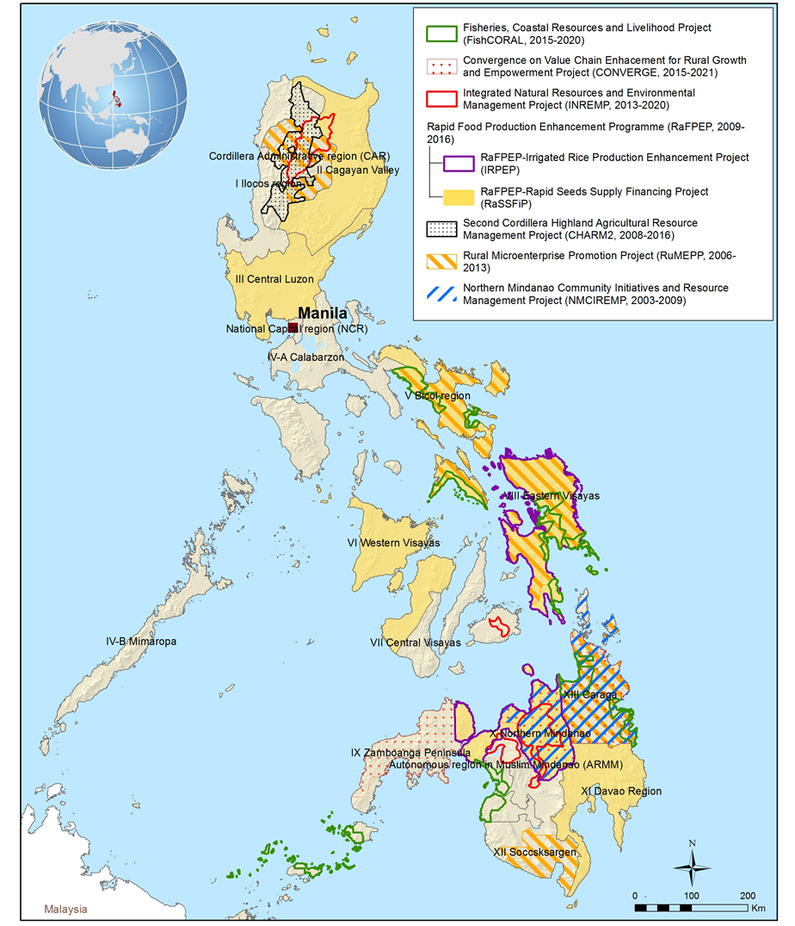
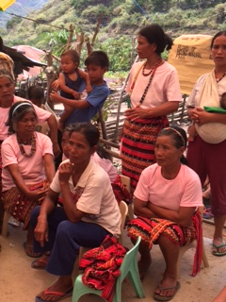
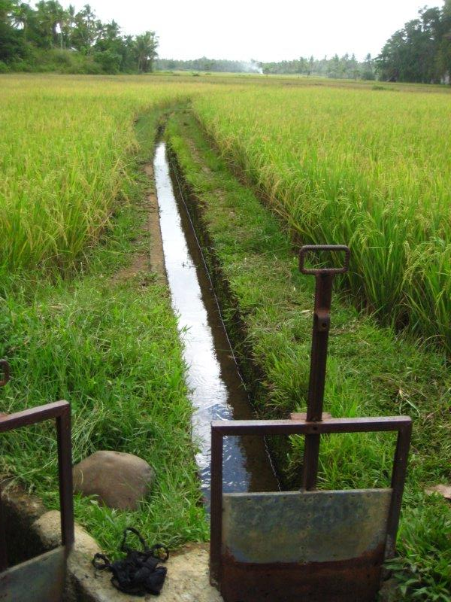
IFAD lending portfolio covered in CSPE
6

Slide 7
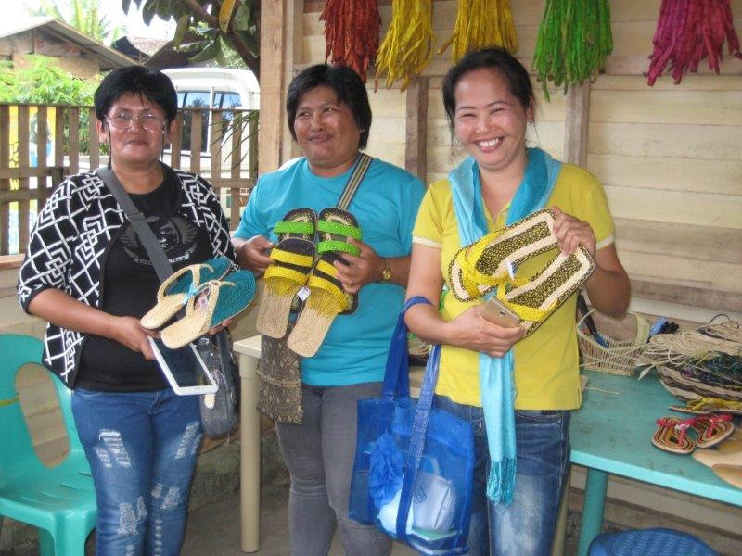
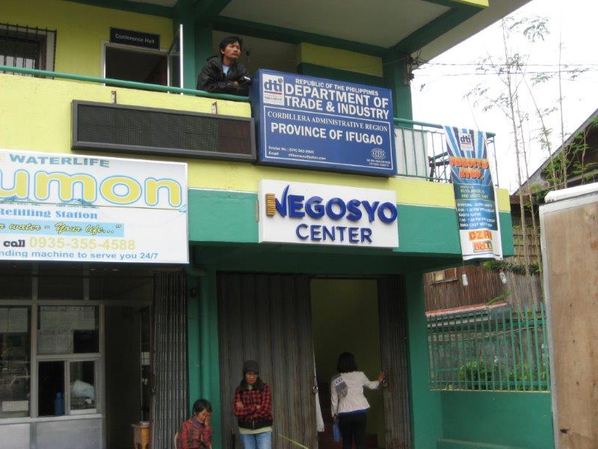
Main evaluation findings - highlights
Lending portfolio – strengths (1)
Gender equality and women’s empowerment: strong across portfolio
Efforts across the country programme, “IFAD Philippines Gender Network”
Economic opportunities for women and households
Women in leadership positions
Positive influence on institutions and policies, especially:
Support to microenterprise development
Contribution to “convergence”
Strengthening participatory development processes
Enhanced representation of IPs in local governance
7

Slide 8
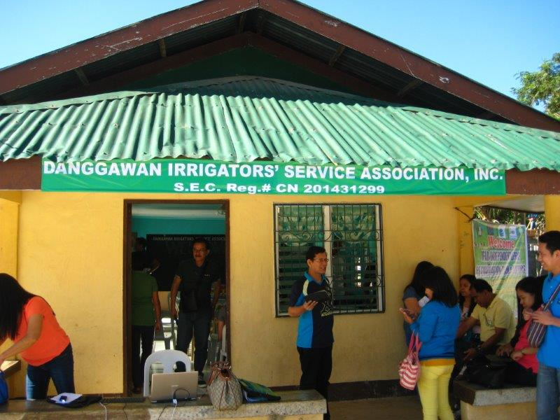
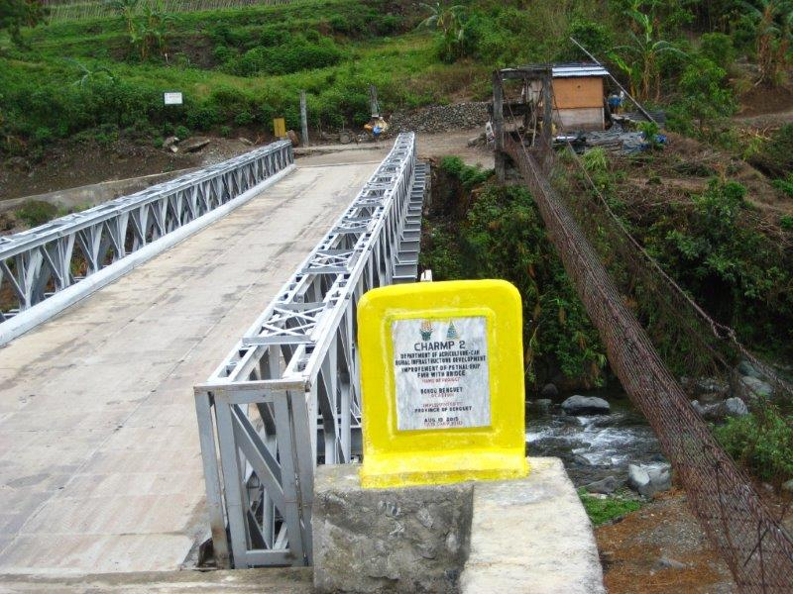
Main evaluation findings - highlights
Lending portfolio – strengths (2)
Investment in communal irrigation systems
Strengthening of irrigators’ associations (IAs)
IAs: clear mandate, institutional home and support by NIA
Good prospect for sustainability of benefits
Rural infrastructure: commitment and ownership (communities and LGUs), fees collection
Conducive institutional and policy framework
8

Slide 9
Main evaluation findings - highlights
Lending portfolio – challenges and issues (1)
Considerable time lags from design to approval, and delays in initial years of implementation
Lack of clarity in the target group (e.g. land tenure status of CIS farmers; microenterprise support vis-à-vis job creation)
Land titling for ancestral domains: earlier successes in NMCIREMP, but challenges in CAR/CHARMP2
Different contexts of IPs, e.g. in CAR and Mindanao
Institutional framework, changing or inconsistent interpretation and application of policies and regulations
9

Slide 10
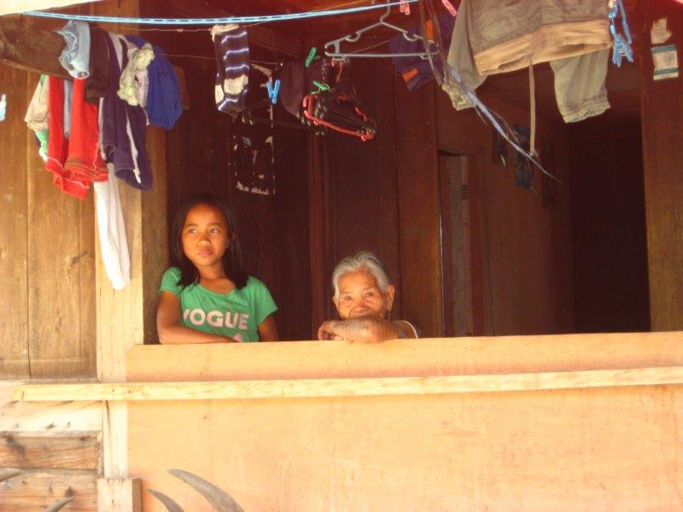
Main evaluation findings - highlights
Lending portfolio – challenges and issues (2)
Support to/through beneficiaries' groups – but their roles not always clear, with the exception of irrigators' associations
Emergency response with agricultural inputs distribution - 2008 food crisis & Haiyan (grant)
Rapid project processing but implementation delays
Is IFAD well-placed to provide short-term emergency support?
M&E – lack of reliable data on outcomes/impact hampering evidence-based analysis
10

Slide 11
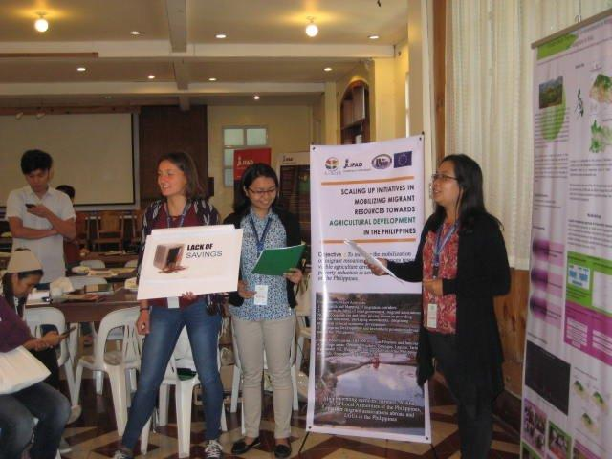
Main evaluation findings - highlights
Non-lending activities - strengths
Knowledge management - set out as an integrated part of the country programme
KM platforms (ACPoR, KLM-PE, Gender Network) effective for experience sharing and cross fertilization
Good linkages between the loan- and grant-financed projects
Some good examples of issues arising from the country programme for policy discussions (e.g. National Government-LGU cost sharing)
Good extensive partnerships with government agencies, civil society organizations and research organizations
11
Notes:
e.g. CBARDP: 207 selected village areas, 28,116 investments into community infrastructure, sustainable agricultural development, rural enterprise and financial linkages support and gender and vulnerable group development

Slide 12
Main evaluation findings - highlights
Non-lending activities – challenges
Missing element in good KM performance: a way of channeling knowledge to inform policy discussions
Original objectives for policy dialogue in the country strategy – overambitious
Collaboration and partnerships with international development agencies and the private sector – less than other actors
12
Notes:
e.g. CBARDP: 207 selected village areas, 28,116 investments into community infrastructure, sustainable agricultural development, rural enterprise and financial linkages support and gender and vulnerable group development

Slide 13
Synthesis and conclusions (1)
Mixed story of successful practices and results, and delays in project processing and portfolio progress
Good performance and practices mainly across and between projects, e.g. KM, loan-grant linkage, contribution to “convergence”
Elements of country programme generally aligned with Government and IFAD policies, but 2009 country strategy document lacked clarity
“Strategic objectives” – formulated around each loan-financed project, without reflection on linkage between different elements
Stated intention of focusing on “20 poorest provinces” - not practicable
13

Slide 14
Synthesis and conclusions (2)
Wide geographical coverage
A multitude of activities and low intensity of investment
Weak M&E at project level
Improved portfolio performance
Upgrading of M&E and KM to be fed into policy engagement processes and scaling-up
Challenges in demonstrating rural poverty impact and generating lessons
Key in the future programme
14

Slide 15
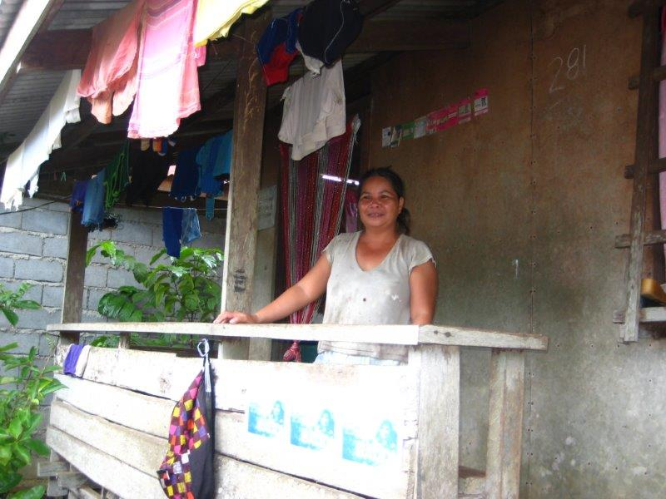
Recommendations
Carefully reflect on IFAD's strengths in new country strategy, including opportunities for non-financing support:
Target group (e.g. indigenous peoples, fisher folks, women) and priority thematic areas (e.g. land tenure security)
Explicit focus on using learning from projects to support policy issues
Attention to vulnerability and risk assessment
Clarity on the target group and targeting approach
Different strategies based on constraints and opportunities of intended beneficiaries
Monitoring of outreach, beneficiary profiles
Increased intensity of investment for better likelihood of palpable impact
15

Slide 16
Recommendations (cont.d)
Strengthen leverage for policy engagement by improving the quality of knowledge and evidence
Opportunities to work with NEDA and DBM in support of national results-based M&E initiative
Support to line departments and LGUs to improve M&E
IFAD country office to be resourced to upgrade support to analytical studies, policy and strategy issues
Strengthen partnerships with development partners
International development agencies to collaborate on analytical work on rural issues and advisory support, project preparation
Private sector actors with potential to help value chain development
16

Slide 17
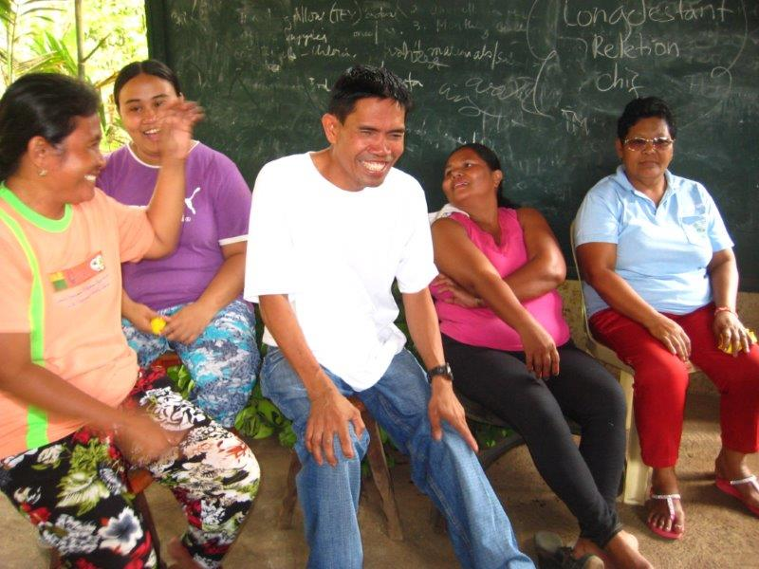
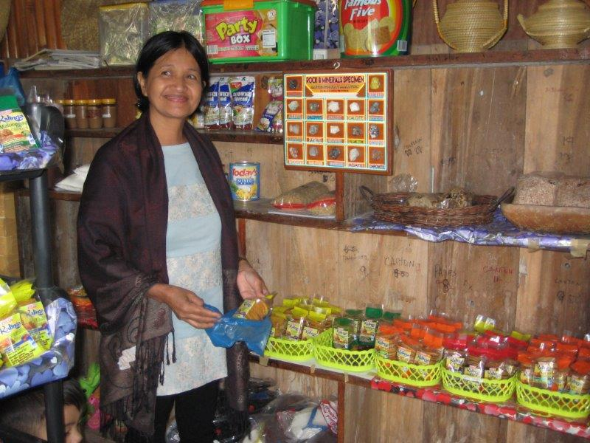
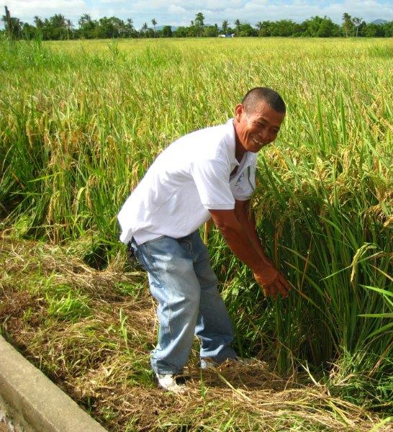
Thank you for your attention and support!
Salamat!

