Slide 1
An evaluation architecture to support learning and accountability
The Example of the Independent Office of Evaluation (IOE) of IFAD
AFREA Conference Kampala
14 April 2017

Slide 2
Evaluation at IFAD over time
1978
Monitoring and Evaluation Unit
1982
Monitoring and Evaluation Division
1994
Office of Evaluation and Studies
2003
Office of Evaluation
(Evaluation Policy: independent evaluation function)
2011
Independent Office of Evaluation
(Revised Evaluation Policy)
2

Slide 3
Evaluation Policy: key elements
Purpose:
Accountability of performance and results and
Learning to ensure usefulness of evaluation recommendations
Principles:
Independence of IOE, its work programme, budget and staffing
Credibility - Evidence-based analysis
Use - Partnership for a transparent and informed process
3

Slide 4
Accountability structure
Executive Board (EB) directly supervises IOE, approves IOE’s annual work programme and budget, selects, appoints and dismisses IOE Director and assesses impact of IFAD’s operations
Evaluation Committee (EC) is a sub-committee of the EB and ensures full implementation of and compliance with IFAD Evaluation Policy. Conducts reviews of selected evaluation reports and IOE’s annual work programme and budget
4

Slide 5
Architecture of IOE Evaluation Products
5

Slide 6
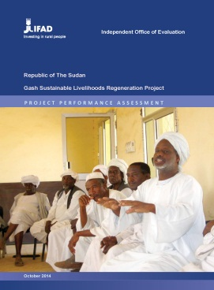
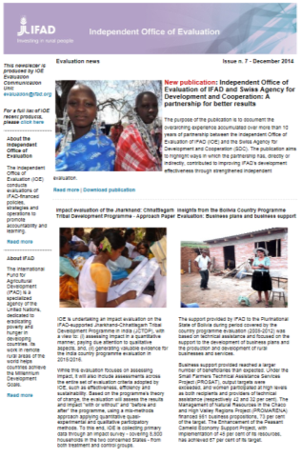
Main Evaluation Products
Evaluation reports
Other publications
ARRI
Ten years independent evaluation booklet
Corporate-level
Impact
A partnership for better results (IOE-SDC)
Overview booklet of a corporate-level evaluation
Country programme
Synthesis
Project
IOE brochure
Newsletter
6

Slide 7
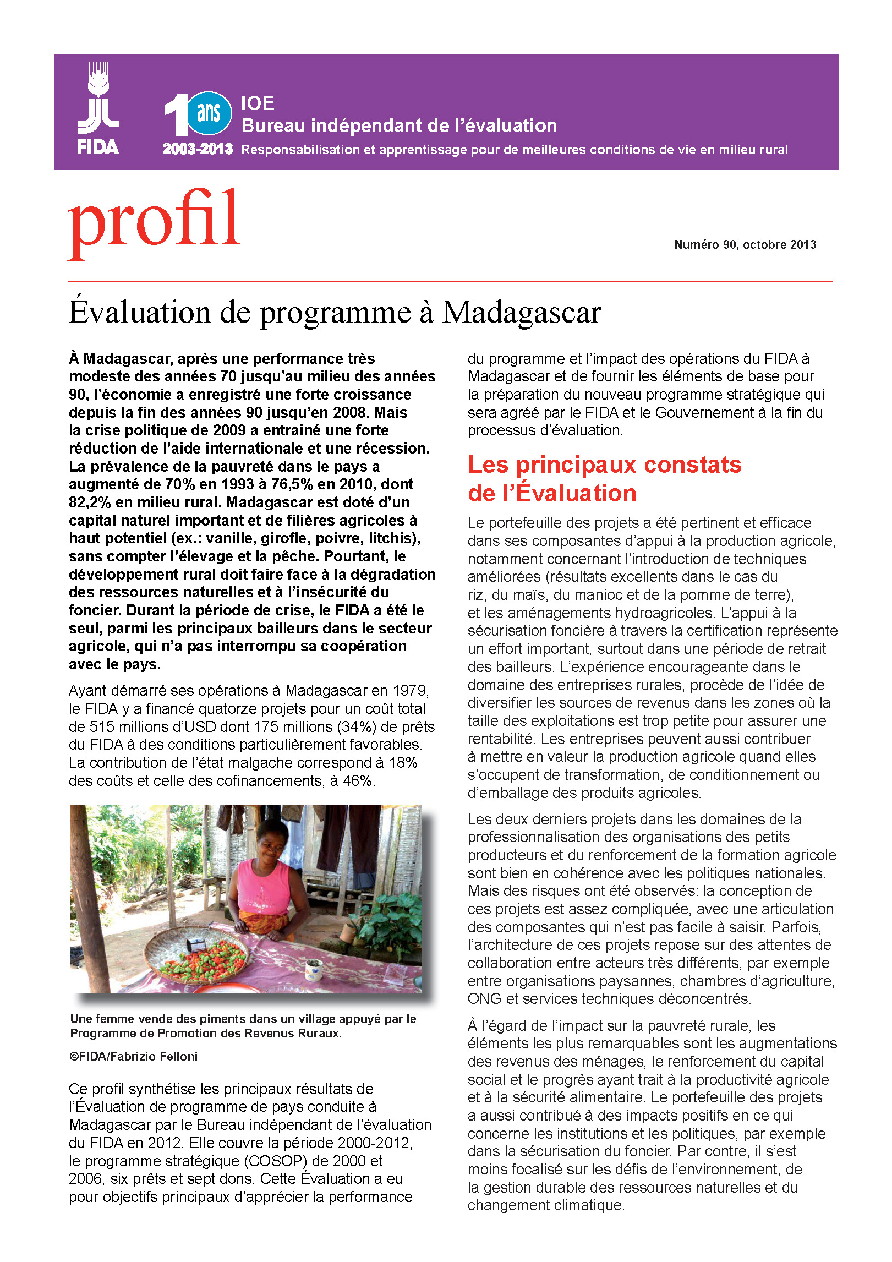
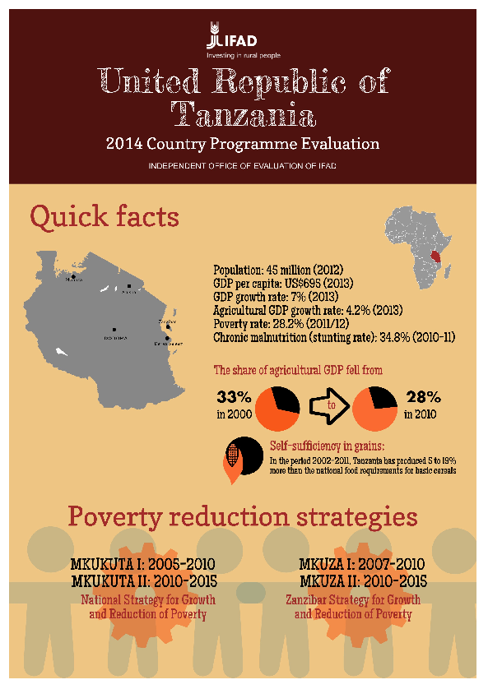
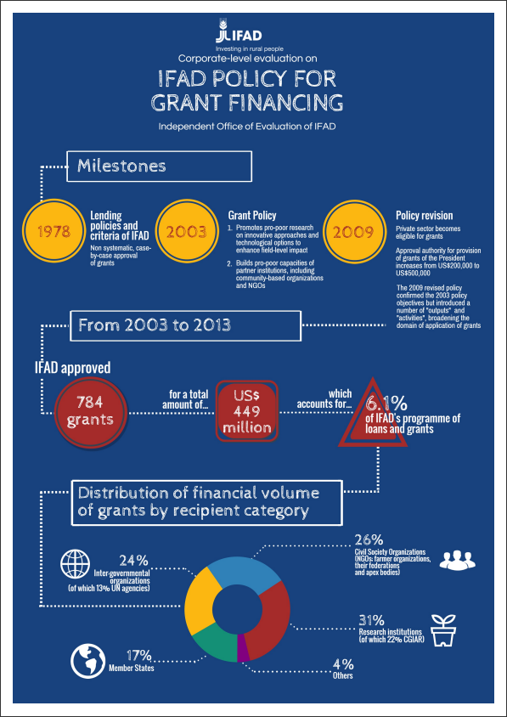
Other Evaluation Products
Evaluation briefs
Profiles - summary of the evaluation report, focusing on 3 or 4 key recommendations from the evaluation.
Insights - focus on ONE key learning issue emerging from the evaluation.
Visual sheets
7

Slide 8
IFAD Management’s Response System
IFAD Management’s response
Agreement at Completion Point for CSPEs (ACP)
President’s Report on the Implementation Status of Evaluation Recommendations and Management Actions (PRISMA)
8

Slide 9
IFAD Management’s Response
Consistent follow up by Management and Quality Assurance
Higher number of “complex evaluations” requires follow up over several years
Issues consistently raised by IOE evaluations (e.g. targeting, M&E, private sector involvement, policy engagement, gender) received increased attention and follow up.
Knowledge generated and consistent follow up seen as contributing to IFAD’s operational effectiveness and efficiency
9

Slide 10
Recommendation uptake - trends
PRISMA 2016 shows high uptake of IOE recommendations (94%)
Followed up and/ or ongoing
Not followed up
10

Slide 11
Client feedback survey
Evaluation reports still main source of information
>50% regularly or often read IOE evaluation reports
Preferred access through IOE website (55%)
Executive summary main source of information on evaluation findings (70%)
Full report read by 44% of respondents
Quality of reports rated positively by 94%
Survey conducted in September 2016; 119 respondents (10.8%)
11

Slide 12
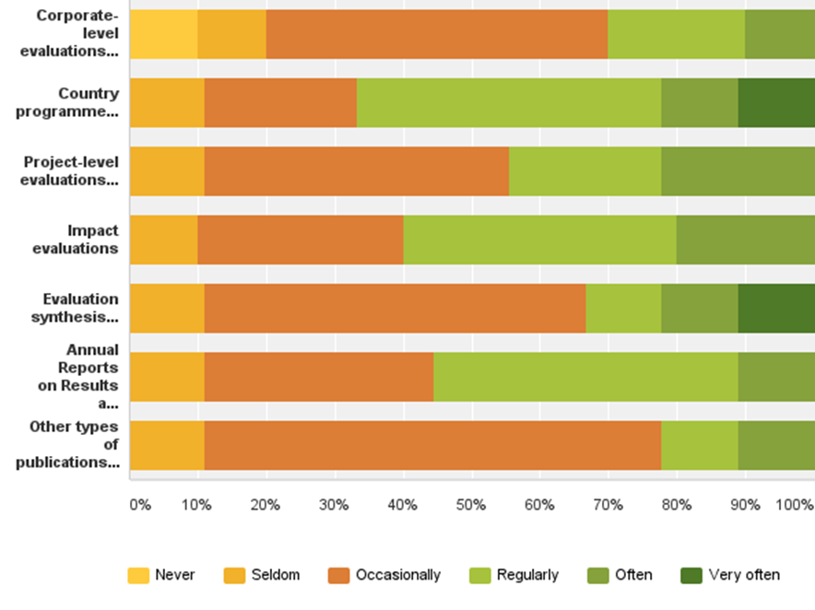
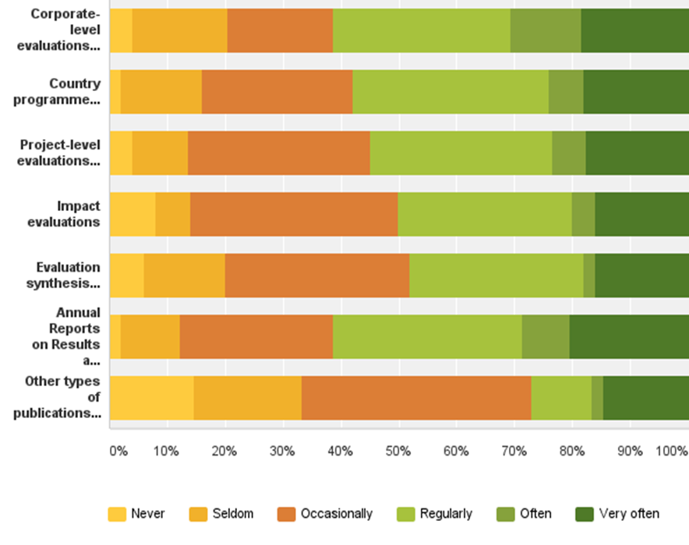
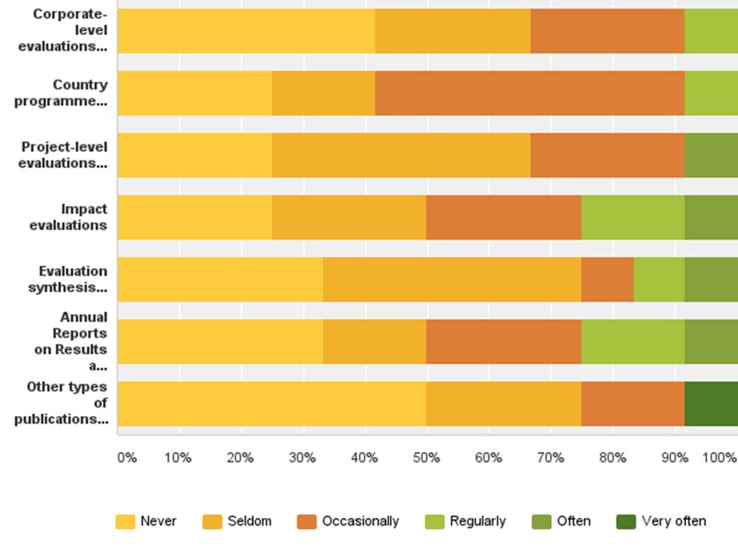
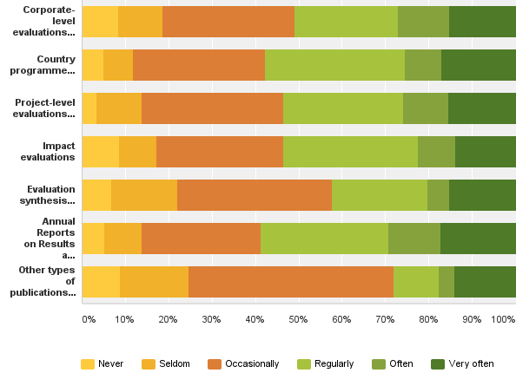
How often have you read these IOE reports in the last two years?
Government
IFAD Staff member
Donors and international organizations
Respondents Familiar with IOE Products
12

Slide 13
Feedback Survey - Findings
Persuasiveness of evaluation findings still depends on the quality of evaluation reports (peer review system)
Government considers different types of evaluations
Some types of evaluations have insufficient outreach to the intended audiences (impact evaluations, evaluation syntheses)
Direct interaction (events) preferred for learning
13

Slide 14
Overall Conclusions
Uptake of evaluation findings firmly institutionalized in IFAD – internal and external legitimization (Harberger, 2011)
Focus on report quality to ensure credibility
Diversity of evaluation products and resulting recommendations require absorptive capacity within programme management
Direct interaction between evaluators and users (events) primarily supports learning function
Communication function important to support learning
14

