Slide 1
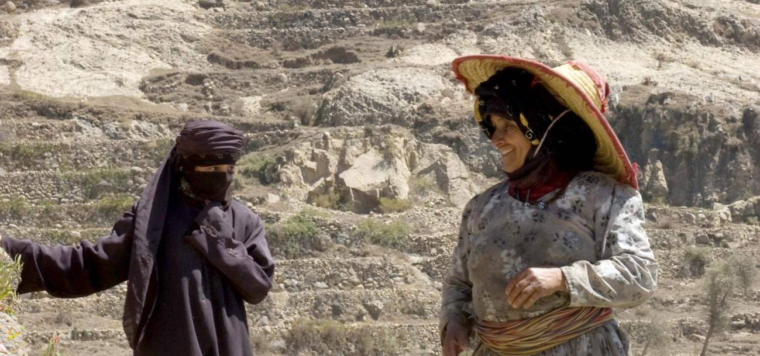
What Works on Gender Equality and Women’s Empowerment
Methodology and Selected Practices and Results by IOE
Notes:
IFAD’s mandate - to reduce rural poverty through investments in agriculture and rural development
Gender equality is at the heart of IFAD’s mandate and closely linked to IFAD\’s commitment to eradicating rural poverty in developing countries
Many of IFAD’s policies have gender considerations embedded in them – targeting policy; policy on indigenous peoples;
Gender policy 2012
IFAD’s strategic plan (2016-2025) includes targeting, empowerment, gender equality among the five principles of engagement – recognizes that poverty is frequently a consequence of the way rural people are marginalised
For the Tenth Replenishment of IFAD’s resources (IFAD10) period, IFAD has committed to improve its performance on gender practice, in particular the share of GEWE interventions aiming at transformative change

Slide 2
Synthesis objectives and scope
Objectives
  Identify gender-transformative practices that can inform future IFAD interventions under Agenda 2030
  Identify key factors enabling (or hindering) GEWE
Scope
  Focus on IFAD lending operations
  Practices documented in IOE evaluations since 2011
Systematic review
  Extracting practices and results from a representative sample of 57 evaluations
Notes:
Corporate level evaluation 2010 of gender in IFAD; mid term evaluation of gender policy undertaken by programme management in 2016 – gender architecture
Complement this effort – synthesis evaluation – lessons steming from evaluations -
To promote learning, collective reflection and improve development effectiveness
Introduced following peer review of IFAD in 2010
To facilitate wider use of evaluation findings
Link the exercise to SDG Agenda – transformative change
No agreed definition of what transformative change meant
Questions: Which strategies and interventions – and at what level – were successful in achieving sustainable GEWE results, as outlined in the IFAD gender policy? To what extent did they contribute to transformative GEWE change?
Which strategies and interventions did not work?
What are the key factors (including contextual factors) explaining success or failure?

Slide 3
Data collection strategy
Notes:
So how did we go about this?
Screening of all IOE evaluations with GEWE ratings
Identified the ones in which GEWE interventions were well documented - according to predefined criteria (complements, robustness) good gender ratings – poor practices, regional balance and components. – 57 reports
Added contextual information Typology counted practices and
Cross checked with other organisations
Comparative review of GEWE practices that have worked elsewhere in the context of similar interventions or sectors helped to identify general lessons
e.g. working with men is critical as they are often gatekeeper's of customary practices that limit women’s access to resources or public spaces
What gender transformative change means depends on the context. Different benchmarks are needed for different contexts, but good contextual analysis is a general prerequisite

Slide 4
Analysis
ToC as analytical framework
Synthesising evidence from matrices according to practices and results
Quantitative analysis of transformation scores
33 case studies, to understand factors for success and failure and context
Lessons learned from other partners

Slide 5
IFAD Theory of Change on GEWE
Notes:
Because there was no agreed definiton of tranformational changes we developed a ToC which lays out the pathways to Gender equality and Womens Empowerment.
Not one but multiple pathways (the broad arrows from left to right), it illustrates the diversity of interventions that may have an impact on GEWE
On the right side of the TOC - the ultimate GEWE impact. This is an integral part of Sustainable Development and Equitable Poverty Reduction and is IFAD’s Strategic Framework Goal
It also includes the more ambitious and transformative nature of Agenda 2030 goals:
- Equity – focus on conditions of access to assets and opportunities
Inclusion, highlighting the multidimensional and ‘deeper’ nature of constraints women face
Non discrimination which describes individuals or groups being denied opportunities to access
As is common in a ToC the impact on the right is not measurable or expected to be measured within the scope of projects or interventions – measurable change is found on the left
GEWE contributes to the ultimate impact in two ways, each considered transformational in the sense of Agenda 2030; First , the ‘no one left behind’ agenda is articulated as providing equal benefits to those hardest to reach; this means reaching women, but also the most marginalised of women, as women do not form a homogeneous group, and gender needs to be specific to context, location ethnicity etc
Second, a transformational agenda is not just about benefits to poor women, but is also about addressing the economic, political and cultural barriers of gender inequality
These changes are expected to be achieved through measurable changes (stated GEWE results) in four areas;
improved access to ressources and opportunities;
more equal work burden and reduced time poverty;
increased decision making power at various levels; and
changes in norms and values around gender equality.
It is expected that these dimensions of empowerment are likely to interact and be interdependent.
The strategies on the left of the TOC describe the various approaches and instruments put in place by IFAD within the various programmes and projects (in line with policy action areas in the IFAD gender policy). This highlights the importance of both gender mainstreaming and targeted interventions (through projects or project components). It also notes the importance of training staff at various levels, particularly to ensure sensitivity to possible underlying gender discrimination. Society wide gender constraints and women’s rights are not necessarily addressed in projects, but awareness of these are important for successful GEWE interventions.
Finally, the TOC stresses the need for monitoring instruments to be disaggregated by gender, as well as cross cutting axes, such as ethnicity, race and location

Slide 6
GEWE Practices
Notes:
Within the sample of 57 evaluations, the synthesis identified 121 GEWE practices. Based on the four main practice areas of the TOC, The largest practice area is around women’s economic resources and opportunities
Improving women’s access to ressources and opportunities (39 percent -47 practices)
Addressing political, legal and institutional constraints (29 practices or 24 per cent) and
Strengthening women’s and men’s awareness, consciousness and confidence (30 practices or 25 per cent)
Reducing women’s time poverty (14 practices or 12 percent)

Slide 7
GEWE effectiveness quadrant
 | More effective (consistent results evidenced) | Less effective (mixed results evidenced)
More common | Breaking gender roles and stereotypes Representation and voice in local governance institutions Functional skills training | Inclusive financial services Infrastructure
Less common | Labour-saving technologies and practices Off-farm employment Establishing value chains, access to markets Technical and vocational training Working with men | Child care support Backyard and home gardens Promotion of IGAs Policy engagement at national and local levels Legal rights on land and forests
Notes:
Practices which were found more effective in contributing to GEWE on the left side
On the right side are the practices which were found less effective because evidence on their contribution to GEWE provides a rather mixed picture. This does not mean their contribution are not effective in principle.
Evidence shows that the contribution of rural finance interventions to GEWE was mixed. Many projects report large number s of women beneficiaries, but often this was the result of self-targeting or other supporting factor. Financial services were found more gender inclusive, where they worked with providers specifically serving women. example
Infrastructure needs to be combined with other practices to make an effective contribution to GEWE - example
More positive picture emerges from the review of practices to enhance women’s participation in public life – awareness and confidence – include example
Value chains and marketing make a contribution to GEWE backyard garden can help enhance women’s role in household food production but were found less transformative

Slide 8
Key lessons
Empowering and gender transformative approaches need to be integrated into project design.
Multiple and complementary practices are more likely to facilitate changes in gender roles and relations.
Working with men as gatekeepers of customary practices is critical.
Participatory approaches can facilitate gender-inclusive outcomes, if combined with specific strategies to target women.
Promoting unconventional and new roles for women helps shifting mindsets and commonly held beliefs.

Slide 9
Key conclusions
Guidance by IFAD gender policy and action plan ensured that interventions address key GEWE issues.
IFAD has addressed root causes of gender inequality and women’s powerlessness, in particular illiteracy, exclusion from access to resources and limited social capital.
Explicit specific strategies to target women critical to ensuring that women benefit equally and that their strategic needs are addressed.
Diversity of women along lines of ethnicity, religion, and life cycle, not sufficiently targeted.
GEWE outcomes and impacts not well documented.

Slide 10
Implications for IOE
Improve documentation of GEWE outcomes and impacts, using methodologies for measuring gender transformative changes (e.g. case studies and participatory and qualitative research)
Notes:
Ratings 4 and 5

Slide 11
UN Guidance for Evaluation
Granular data to monitor vulnerable and hard to reach populations (e.g. migrants, youth, women, displaced persons, ethnic minorities)
Evaluation design and approach to address relevant human rights and gender equality aspects through evaluation criteria, questions, data collection and analysis
Evaluation process –inclusive and diverse stakeholder engagement; adaptive process to accommodate complexity
Evaluation team – appropriate gender balance and geographical diversity.
* UNEG norms and standards for evaluation 2016

Slide 12
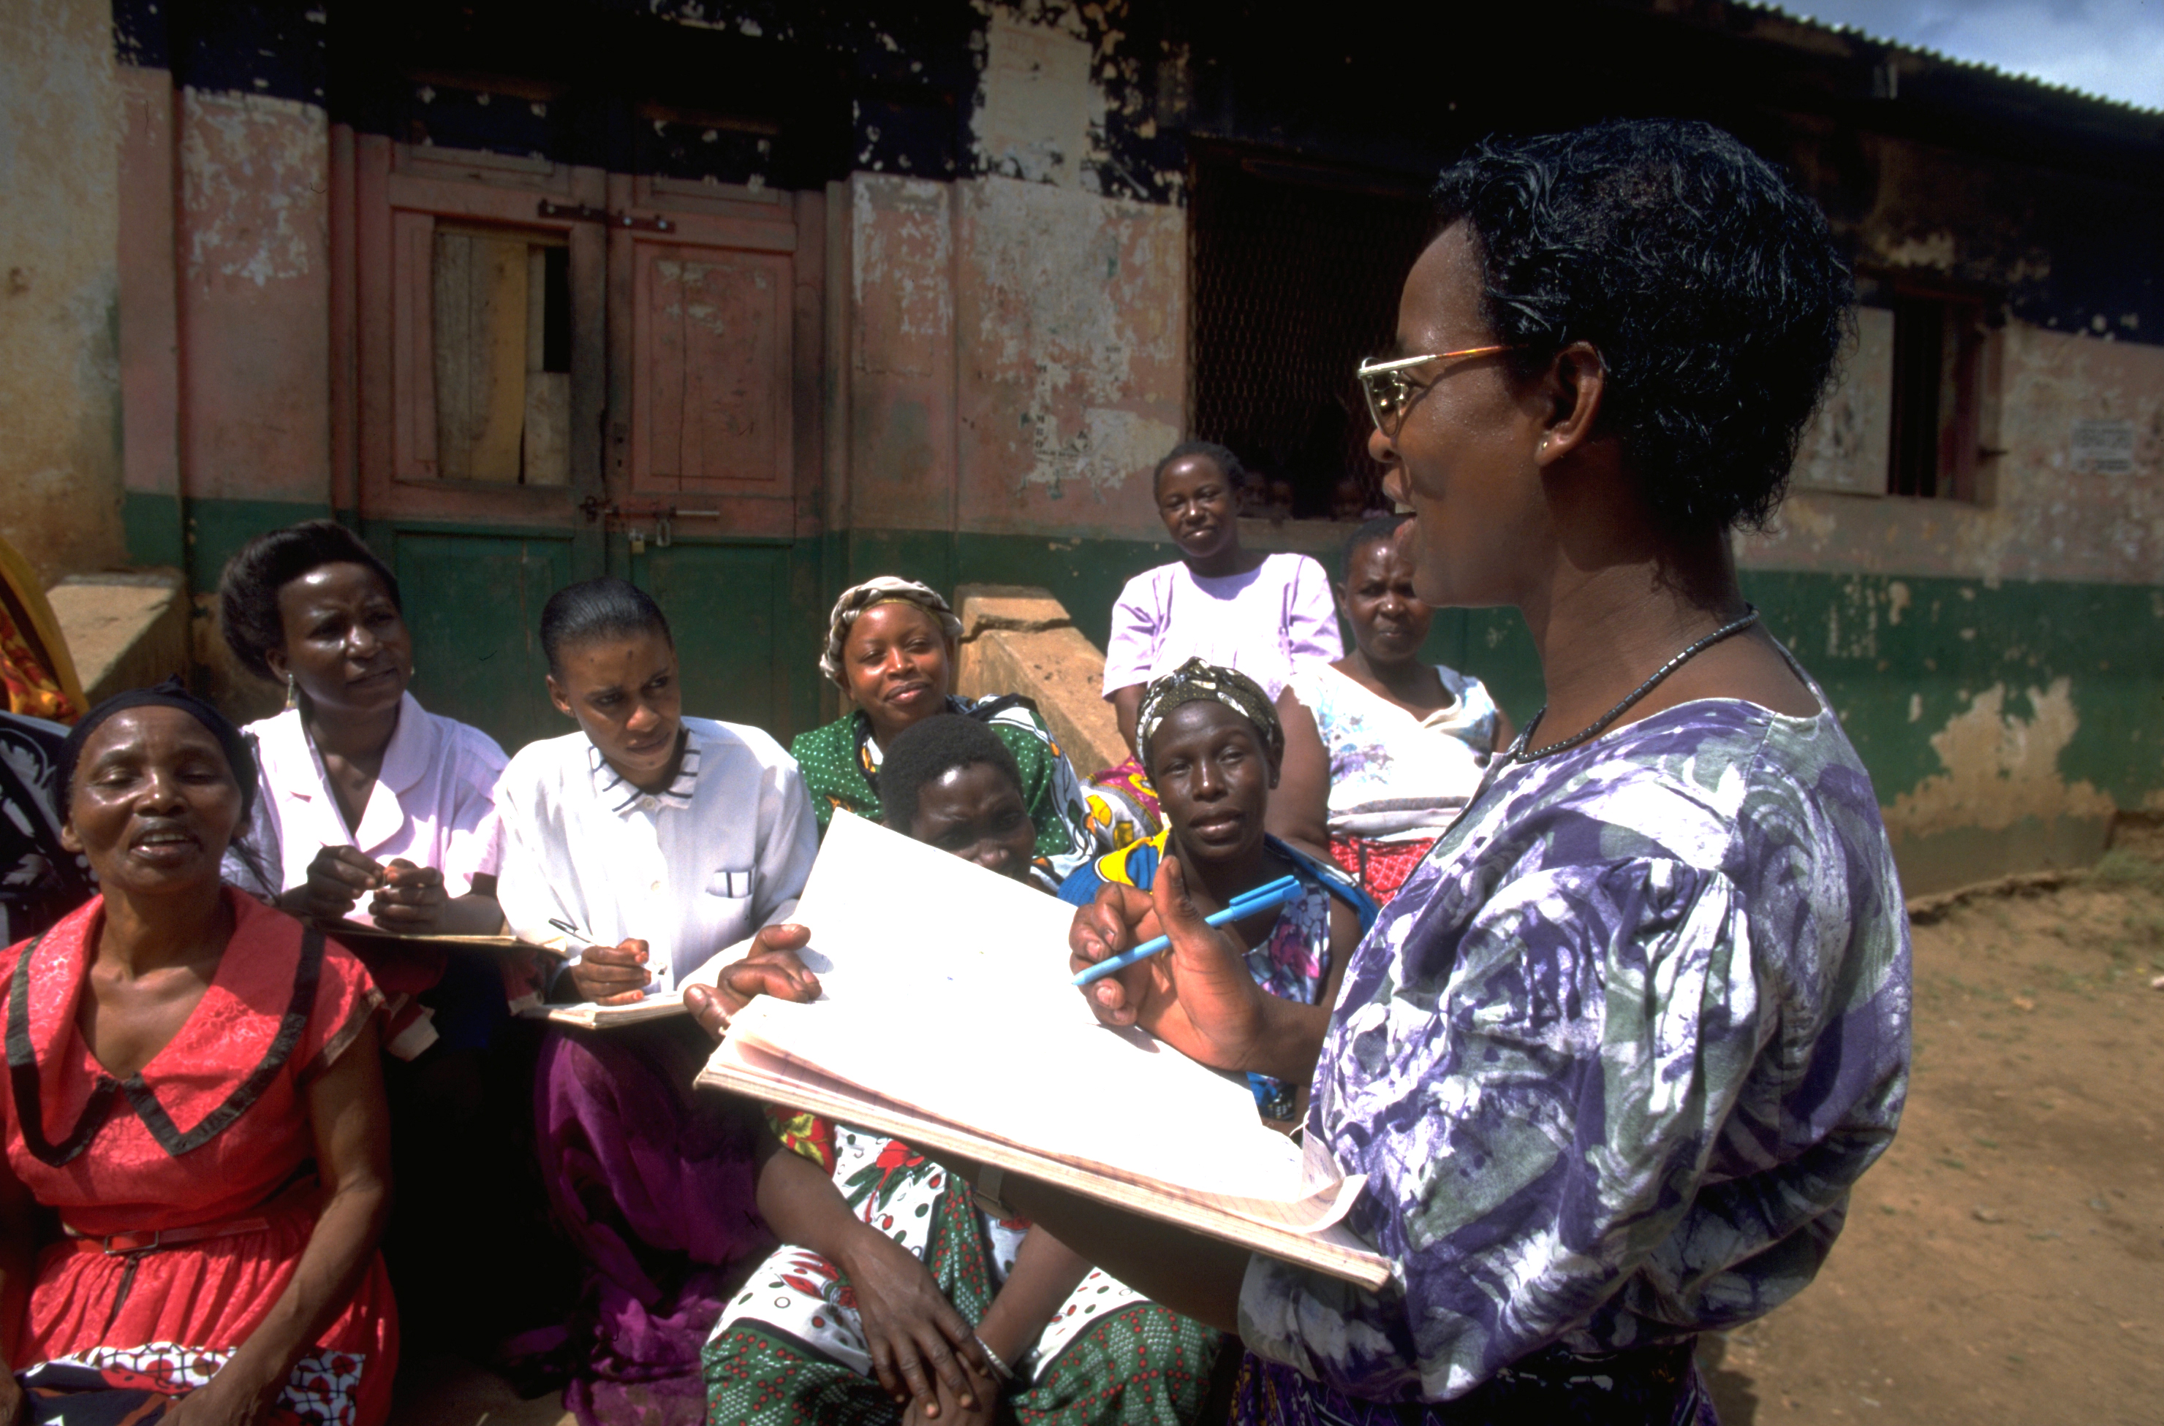
Thank you

