Slide 1
Country Strategy and Programme Evaluation for the Arab Republic of Egypt
National Workshop, 26 November 2017, Cairo

Slide 2
CSPE scope
Period since last CPE (2005 – 2016)
CSPE covers 9 projects (4 closed, 4 ongoing, 1 cancelled) and 35 grants (regional and country);
Non-lending activities (policy engagement, partnership-building, knowledge management)
Main mission (October 2016), including field visits in Upper Egypt (Luxor, Qena, Sohaq, Assiut), Middle Egypt (Fayoum, Beni Suef), and Lower Egypt (Beiheira, Kafr El Sheik)
Project Performance Evaluation of WNRDP

Slide 3
Lending portfolio overview
Total portfolio over CSPE period US$580,2 million), IFAD (loans and grants) US$239,2 million)
Portfolio: rural credit (42%), irrigation (20%), rural infrastructure (14%) and technology development and transfer (7%)
Lending terms moved from “highly concessional” to “intermediate” (2002) to “ordinary” (2011)
IFAD loan primarily used for rural credit and irrigation infrastructure

Slide 4
Main strategic threads
Strengthening agricultural productivity in the old lands through improved farming systems and more efficient use of land and water resources
Improving settlements in the new lands, through provision of comprehensive infrastructure and sustainable land and water management practices
Supporting economic diversification and employment generation through rural finance and capacity-building

Slide 5
Main achievements
What | How much | Where
Land with improved irrigation | 77487 feddans | New lands
Farmers field schools (no) | 337 | Upper & Middle Egypt
Female extension staff (no) | 385 | Upper & Middle Egypt
Agric. extension (no of farmers) | 497.210 | Middle Egypt
Farmers with new farming systems | 68% | Middle Egypt
Agric. extension (no of farmers) | 63.359 | New lands
Water user associations (no) | 572 | Mainly new lands
Micro loans (no) | 137.591 | Upper & Lower Egypt
Micro loans to women (no) | 47.126 | Upper & Middle Egypt
Infrastructure (people covered) | 4.3 mil. | Sohaq
Infrastructure (people covered) | 128.701 | New lands

Slide 6
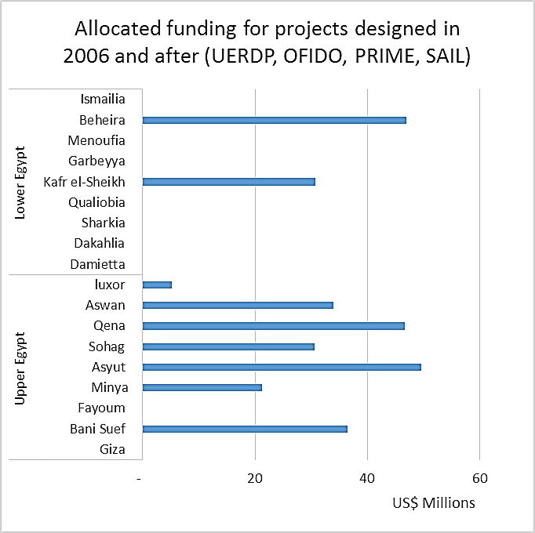
Relevance – Poverty focus
Poverty focus - 8 out of 13 governorates covered below national poverty rate (27.8% in 2014/2015)
Programme shift to Upper Egypt during CSPE period
Focus on smallholders, landless, women and unemployed youth
Continuity and building on well-tested approaches

Slide 7
Effectiveness
Concentrated delivery of integrated package of support (new lands) was effective
Introducing integrated farming systems through research and extension and farmers’ field schools was also effective
Performance of rural credit components has been weak; improved with the shift to new partners
Large number of community organizations has been created or strengthened, but, capacity- building has been insufficient.

Slide 8
Efficiency
Time between design and implementation significantly reduced
Delays in project start-up slow disbursement and high management overheads
Interventions were cost-efficient due to low-cost technical solutions and use of local institutions for extension and research
Centralized management units cost efficient, but less effective
Larger projects not more efficient; high overheads

Slide 9
Sustainability
Technical sustainability good: irrigation and drainage, improved farming systems
Farmers’ field schools and technical support services still operational
Community organizations partly sustainable – role in operation and maintenance not assured
Approach to rural finance not sustainable; lacks mechanisms for cost recovery; interest rates are subsidized; requires more capacity-building

Slide 10
Rural poverty impact
Positive impact on agricultural productivity through improved farming systems (old lands) and water and land management (new lands)
Micro-lending has enabled smallholders to procure inputs and assets, in particular livestock
Settlement development helped strengthening social and human capital in the new lands
Limited contribution to non-agricultural diversification and job creation

Slide 11
Gender Equality & Women’s Empowerment
Women improved access to credit, participation in community decision making, overall wellbeing.
Good practices to support outreach to women: Gender specialist within the PMU; female extension workers, women-only CDAs and women groups
Specific activities targeting women: Literacy classes, ID cards, social services, income-generating activities, CDA micro-finance, SME loans.

Slide 12
Natural resource management
Efficient use of land and water resources – major theme in loans and grants portfolio, but not consistently addressed
Eastern Delta: comprehensive water management, including drainage and water reuse
Sohaq: sanitation and waste water treatment
SAIL: climate-smart practices promoted in the new lands (ASAP grant)
ICARDA grant: raised-bed technology for water conservation

Slide 13
Non-lending activities
Grants portfolio focussed on relevant issues (e.g. NRM); no effective linkages with local partners or operations to enable uptake of results
Loan-component grants not used to leverage effective capacity building and innovation
IFAD managed knowledge at regional level; less attention to Government’s role and ownership
Lessons not systematically learned from operations; good practices were lost

Slide 14
Non-lending activities
Partnerships have been good with key implementing partners
CPMU provided a reliable entry-point into Government, but capacity insufficient to convene sector-wide coordination and dialogue
Co-funding with the World Bank and Italian Government in the early period, not followed up
Policy engagement around lending operations; mainly through supervision and implementation support

Slide 15
Overall country programme & strategy
Strategy addressed Government’s needs and funding gaps, in particular in the new lands.
Alignment with Government policies was partial and selective. Regional diversity, food security and gender equality not specifically addressed.
Strategy did not envisage re-focus on the new lands as undertaken during the 2015 MTR.
Limited contribution to pro-poor sustainable use of resources, sustainable employment, participatory governance and gender equality.

Slide 16
Conclusions
Country programme characterized by high degree of continuity and focus.
Overall poverty focus satisfactory, but programme did not go much beyond a geographic targeting.
Delivery of concentrated and focused approaches effectively addressed poverty issues on a smaller scale.
Rural finance continues to play a pivotal role in the portfolio and its performance and growth will depend on expanded partnerships.

Slide 17
Conclusions (continued)
Knowledge and experience available within the programme was not adequately captured and used to enable progressive learning.
A wider range of partnerships and strengthened coordination of partners key to portfolio development and growth.
Stronger country office will allow increased attention to partnership-building, knowledge management and policy engagement.
Opportunity for strategic repositioning IFAD

Slide 18
Recommendations
Sharpen poverty and geographic focus and refine poverty targeting; improve poverty analysis and monitor disaggregated benefits.
Sharpen thematic focus and improve feasibility of design; disengage from thematic areas where IFAD does not have sufficient implementation experience or strategic partners
Establish structure for effective coordination and technical support within a progressing programmatic approach.

Slide 19
Recommendations (continued)
Manage knowledge from loans and grants to support learning and innovation; establish clear roles and responsibilities in country
Prepare a strategy for effective capacity- building of community-level institutions with a perspective on scaling up; immediate measures:
set up WUAs before irrigation improvement and
ensure effective use of project component grants for capacity-building

