Slide 1

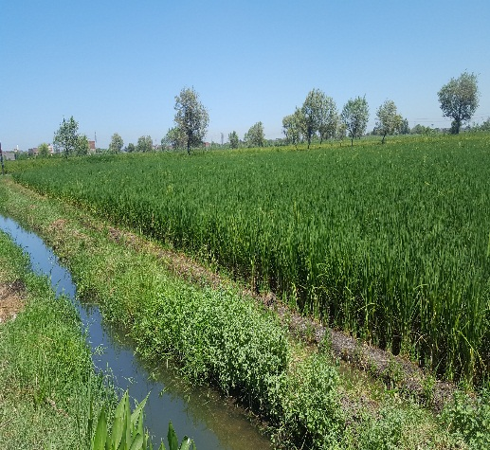
Thematic Evaluation
of
IFAD Country Strategy and Program
2006-2016

Slide 2

Outline
Evaluation Objective and Scope
Evaluation Methodology
Thematic Focus Areas in IFAD Programs
General Recommendations
Rural Finance
Irrigation and Water Management
Marketing and Enterprise Development
Research and Extension Services
Gender
Notes:
First of all: We would like to acknowledge that this report was prepared
prepared thanks to the collective collaboration and efforts of all involved stakeholders.

Slide 3
Evaluation Scope and Methodology
The evaluation covers the period from 2006 to 2016;
  County Strategic Opportunities Program (COSOP) 2006, and
  County Strategic Opportunities Program (COSOP) 2012
The evaluation was conducted in two stages;
  In-depth evaluation of one selected project that operated during the two COSOPs; UERDP from 2006-2016.
  Thematic evaluation of IFAD activities across five selected themes; rural finance, irrigation and water resources, marketing and business promotion, research and extension services, and gender.
Notes:
Assess the extent to which IFAD’s strategies and activities contributed to the socio-economic improvements within selected themes in rural Egypt.
Provide evidence and recommendations that contribute to the design of the new IFAD Country Strategy and Program 2018.

Slide 4
IFAD projects during the period 2006-2016
# | Project Name | Main Area of Intervention |  | Start-End Date |  |  | Total IFAD Financing (US $ millions)
1 | East Delta Newlands Agricultural Services Project | Credit and Financial Services |  | 1999 - 2009 |  |  | 25.3
2 | Sohag Rural Development Project | Rural Development |  | 2001 - 2008 |  |  | 25
3 | West Noubaria Rural Development Project | New Settlements |  | 2003 - 2014 |  |  | 18.5
4 | Upper Egypt Rural Development Project | Credit and Financial Services |  | 2007 - 2017 |  |  | 16
5 | On-farm Irrigation Development Project in the Old lands | Irrigation |  | 2010 - 2018 |  |  | 48
6 | Promotion of Rural Incomes through Market Enhancement | Credit and Financial Services |  | 2014 - 2020 |  |  | 71
7 | Sustainable Agriculture Investments and Livelihoods Project | Credit and Financial Services |  | 2014 - 2022 |  |  | 69.6
 | Total |  |  |  |  |  | 273.4

Slide 5
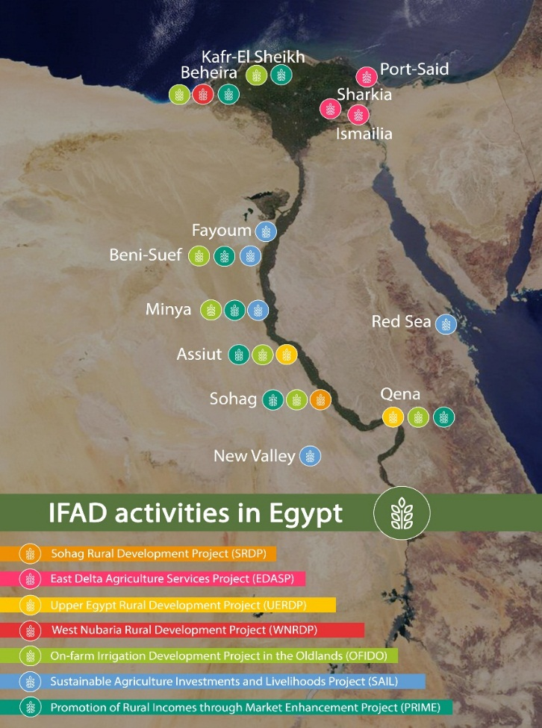
Geographical Locations of IFAD Projects
Projects interventions covered:
Eight Governorates in Upper Egypt: Fayoum, Beni Suef, Minya, Assiut, Sohag, Qena, Red Sea and New Vally.
Three Governorates in Lower Egypt; Kafr El-Sheikh, Beheira and Sharkia.
Two Governorates in Qanal Region; Port Said and Ismailia.
Ten of the thirteen targeted governorates are amongst the governorates with high poverty rates in Egypt.

Slide 6
Rural Finance
Irrigation and Water Management
Gender
Enterprise and Marketing Promotion
Research and Extension Services
Notes:
The project activities in rural finance aimed to enhance the institutional capacities of financial intermediaries to improve their effectiveness and expand their outreach to the private sector, SMEs and the rural poor.

Slide 7
Rural Finance
Objectives
Enhancing rural access to financial services aiming for poverty reduction, income generation, employment creations and livelihood improvement especially of most vulnerable.
Enhancing the institutional capacities of financial intermediaries to improve their effectiveness and expand the outreach to the private sector, SMEs and the rural poor.
Notes:
All seven projects implemented during the timespan of the two COSOPs under evaluation included a rural finance component.
Throughout the projects, financial services were in the form of credit lines and revolving funds delivered through various financial intermediaries.
To expand outreach of services to rural areas, second tier institutions, such as CDAs, commercial banks and ACs were involved in the implementation of activities.

Slide 8
Rural Finance - Delivery Channels
Banks
SMEs
SFD
SEDO
CDAs
Individuals
MSMEs
PBDAC
MSMEs
IFAD
PBDAC
Individuals
Individuals
MALR (ADP)
CIB
SMEs
Notes:
Financial Delivery Channels and Services
SFD credit lines are channeled to end-borrowers at the governorate level through:
Small Enterprise Development Organization (SEDO) which provides small loans to SMEs via PBDAC or the National Bank of Egypt (NBE),
Microfinance Department disburses microloans to CDAs, ACs and Banque Du Caire
ADP, on the other hand, are disbursed to formal financial institutions, mostly commercial banks such as the CIB, National Bank of Egypt, and PBDAC
PBDAC provided SMEs and small individual farmers with small and microloans to finance on and off farm agricultural economic activities.
terms and conditions were considered stringent, but necessary for cost recovery, as well as revolving the funds. Nevertheless, IFAD’s policy of lending to second tier financial institutions appeared to increase the cost of loans borne by end borrowers. Also, the terms and conditions were almost standardized regardless of the type of activity financed, except in the case of cooperatives under OFIDO, whereby a simple declining interest rate was determined based on the project implemented.
Credit Guarantee mechanism by the Credit Guarantee Company (bears 80% of risk) thus encourages financial institutions, especially banks, to take on the role of financial intermediaries, thereby facilitating MSME access to finance. Or Promissory Notes used by PBDAC.

Slide 9
Rural Finance - Findings
SFD: 57,172 loans from 2008 - 2016 with a total of EGP 428 million.
Accessibility and Outreach
  73% of loans financed micro projects with a budget from EGP 1,500 - 14,000.
  Rural poor access was hard to assess
  Multi-level intermediation to Expand outreach.
ADP: 81 loans from 2016 - 2017 with a total of EGP 102 million (EGP 89 million to companies).
Notes:
targeting effectiveness in terms of reaching the poor based on income level, employment status and land size.
Recipients data were not available.
the actual demand on microcredit loans remains to be foreseen
The financial products and services were uniform and did not address the different needs along the value chain, which requires access to a wider range of services, such as savings, leasing, payment services and insurance
ADP
Funds were disbursed to either companies or individuals with each receiving 88% and 12% respectively.
The average loan size ranged from EGP 80 thousand to EGP 4.84 million.

Slide 10
Rural Finance - Findings
Geographic Targeting
SFD activities:
  Intermediaries: 3 banks, 2 ACs and 91 CDAs
  Activities across 9 governorates.
ADP activities:
  funds involved 7 banks
  Activites in 7 governorates.
Notes:
This is due to the fact that the funds allocated to microfinance under UERDP were much higher than any other IFAD project, with UERDP receiving EGP 125.6 million, as opposed to the EGP 10.6 million allocated to OFIDO and PRIME, and UERDP was implemented in Qena and Assiut
Beheira had the highest percentage share of funds, accounting for 90%, which was used to finance 24 projects with an average loan size of EGP 3.9 million. Although Assiut received only 5% of the funds, it recorded the highest number of loans disbursed (28 projects) with an average size of EGP 176,786.
NEEDS
The absence of demand analysis for microfinance services has hindered IFAD's ability to estimate the expected number of active low-income borrowers, and gauge the sufficiency of the loan size in covering operational costs.
PBDAC, SFD, CDAs and commercial banks
CDAs involvement represents a bottom-up approach to engage the local community in development activities, especially in rural areas where the engagement and appropriation are key elements for a project’s success.
Community-level institutions, they were involved due to their outreach to village poor and awareness of community needs
The financial products and services were uniform and did not address the different needs along the value chain, which requires access to a wider range of services, such as savings, leasing, payment services and insurance

Slide 11
Rural Finance - Findings
  Annual Growth rate of revolving funds was estimated at an average of 0.5 % from 2009 to 2012.
  A declining trend was experienced since 2011.
  Additional/alternative financial resources are needed for sustainable operations and effects of rural finance.
Notes:
The aforementioned selection criteria were found to increase the effectiveness of loan disbursement and repayment as will be discussed under Effectiveness. However, they were inefficient in targeting the most vulnerable groups including smallholders

Slide 12
Rural Finance - Recommendation
A situation analysis is needed to gauge the actual demand on microfinance.
Disaggregate data of beneficiaries for measuring targeting of disadvantaged groups to rural financial services.
Introduce a variety of innovative micro-finance products and intermediaries that cater to the needs of the different stakeholders.
Promote capacities of CDAs to enhance effectiveness and efficiency of loan management:
Enhance the coordination with credit bureau, as well as EFSA training.

Slide 13
Rural Finance
Irrigation and Water Management
Gender
Enterprise and Marketing Promotion
Research and Extension Services

Slide 14

Irrigation and Water Resource Management
Objectives
Enhance irrigation systems to rationalize irrigation water use.
Improve water management practices for more equitable distribution.
Promote more effective participation of users and stakeholders in the process of managing water.

Slide 15
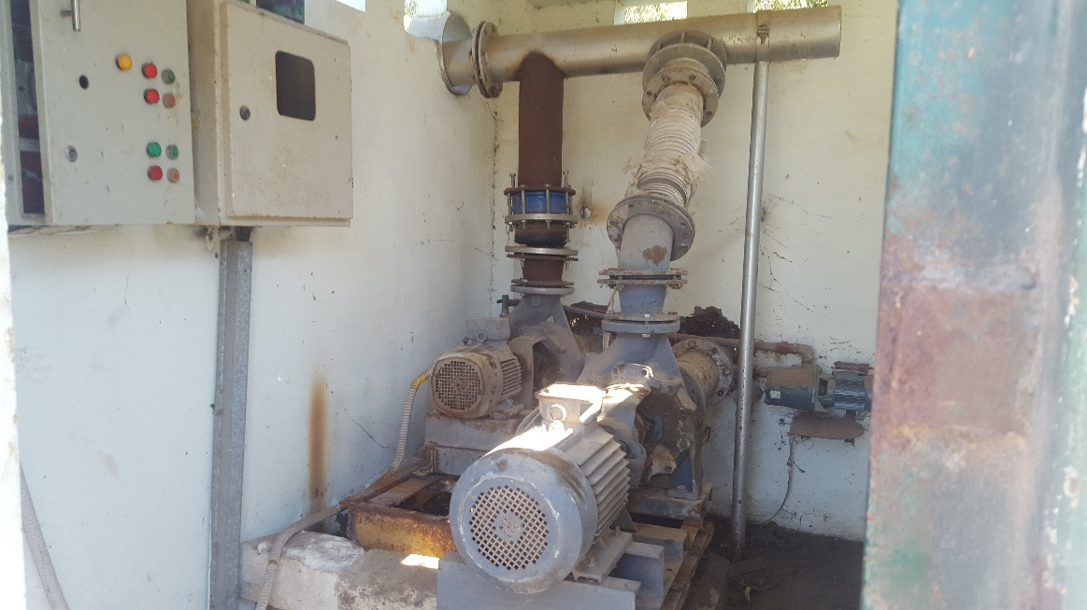
Irrigation and Water Resource Management
The Rehabilitation and Modernization of Irrigation Infrastructure
Old Lands (On-Farm)
  Rehabilitation of irrigation canals.
  Replacing individual small pumps by a single collective electric pumping station.
New Lands
  New irrigation techniques i.e., fixed sprinklers, drip irrigation, and field drainage (mesqa level).
  Solar water pumps and biogas units.
electric pumping station
Notes:
The overall objective was to establish cost-effective and efficient irrigation systems.
Enhance traditional irrigation infrastructure in the old lands by substituting large numbers of individual small pumps that were located in different areas along the tertiary canals by a single collective electric pumping station (single point lifting) and rehabilitating marwas through establishing underground low pressure pipes, which replaced the open canals

Slide 16
Irrigation and Water Resource Management
Water Users Organizations
Promote Collective Action organizations
Represent the interests and concerns of the water users and farmers.
Contribute to the operation and maintenance of irrigation facilities.
Regulate the allocation of water to ensure equitable distribution among users.
WUCs
WUAs
BCWUAs
Notes:
scaled up to higher levels that would guarantee more effective engagement on water management at the different canal levels.
Allow the tail-end users who are the ones mostly affected by the challenges facing the sector, to have voices and decision making channel

Slide 17
Irrigation and Water Resource Management
Findings
The modernization of on-farm irrigation systems proved to be more equitable, convenient and more cost and time-effective in enhancing water-use efficiency than traditional techniques.
The implementations of the modernization of irrigation systems in the old lands encountered delays.
Concerns about quality of the modernized systems were raised.
The absence of a regular maintenance mechanism is considered a major sustainability constraint.
The limited legal status and capacities of the different WUOs is a challenge for effectiveness and sustainability.
Notes:
, but flexibility in the design allowed for improvements.
Challenges including: coordination challenges between the concerned stakeholders, poor harmonization within larger irrigation systems and difficulties encountered in ensuring the availability and consistency of the necessary electricity supply.
WUOs challenges including, coordination complexities between the concerned ministries, and thus poor joint vision regarding the establishment and promotion WUOs.

Slide 18
Irrigation and Water Resource Management
Recommendation
Ensure compatibility with larger irrigation systems , guarantee consistent water supply and clear arrangements for water rotation.
Introduce more diversified on-farm irrigation models and irrigation technologies to better correspond to the specificities and conditions of the targeted areas.
Enhance a more participatory planning approach at the local level.
Empower and enhance the role of WUOs through stronger institutional capacity and advocate for the necessary legal framework.
Notes:
Enhance a more participatory planning approach at the local level. particularly since it comprises the farmers’ commitment to cost recovery.
scaled up to higher levels that would guarantee more effective engagement on water management at the different canal levels.
Allow the tail-end users who are the ones mostly affected by the challenges facing the sector, to have voices and decision making channel

Slide 19
Rural Finance
Irrigation and Water Management
Gender
Enterprise and Marketing Promotion
Research and Extension Services

Slide 20
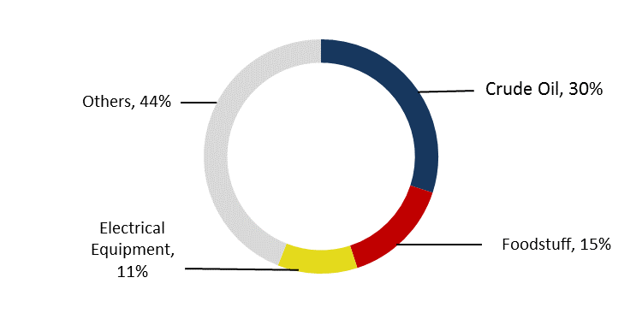
Agricultural Enterprise and Marketing Promotion
Objectives
Support small-scale farmers to act collectively.
Capitalize on available economic opportunities in national and international markets.
  Supporting marketing linkages to value chains.
  Enhance dissemination of market Information.
Top Commodity Contributors to Total Exports, Egypt 2015-2016
Notes:
It still has potential and opportunities to expand and increase its market share

Slide 21
Agricultural Enterprise and Marketing Promotion
Findings
Limited financial allocations and technical support to FMAs.
The effectiveness of FMA’s and capacity building activities varied from the new-lands to the old-lands.
Successful linkages to value chains and export markets were experienced.
The dissemination of marketing information was limited in scope and outreach.
Farmers’ Products in international Markets (UERDP)
Notes:
Efficiency: Allocation of resources/ capacities of personnel/ target vs. created FMAs (?)/ legal status/land size/equipment provision
Effectiveness: the successes that were realized in new-lands projects: connections to value chains/ contract marketing/ high-end marketing varied as a result of the efficiency challenges as well as PMU role.

Slide 22
Agricultural Enterprise and Marketing Promotion
Recommendations
Provision of financial resources and productive assets are needed to empower FMAs.
Technical and advisory support are necessary for small farmers.
Accessible, timely and cost effective marketing information are necessary.
Promotion of contract farming system to include a compensation mechanism to ensure the commitment.
FMA activities in UERDP
Notes:
scaled up to higher levels that would guarantee more effective engagement on water management at the different canal levels.
Allow the tail-end users who are the ones mostly affected by the challenges facing the sector, to have voices and decision making channel

Slide 23
Rural Finance
Irrigation and Water Management
Gender
Enterprise and Marketing Promotion
Research and Extension Services
Notes:
scaled up to higher levels that would guarantee more effective engagement on water management at the different canal levels.
Allow the tail-end users who are the ones mostly affected by the challenges facing the sector, to have voices and decision making channel

Slide 24
Research and Extension Services
Objectives
Strengthening linkages between research and extension services.
Enhancing small farms’ productivity and diversification of crop models.
Introducing of efficient farm and irrigation management systems.
Promoting demand-driven research and technical training.
Increased land productivity and crop variety
Notes:
Irrigation drainage in East Delta and West Nubariya.
The farming system research model developed demand-driven research and extension services for technology transfer and disseminating findings through demonstration plots.

Slide 25
Research and Extension Services
The activities included
In new-lands
Improving irrigation and drainage of reclaimed lands.
Introduced high-value-added crops.
In Old-lands
Implementing farming systems research model.
Disseminating results through demonstration plots, field days, harvest days and farmers field schools.
Demonstration Plots in UERDP
Notes:
IFAD projects is what is known as adaptive research, which was implemented through the farming system research model.
The outreach mechanism for disseminating findings varied among demonstration plots, field days, harvest days, training workshops, and Farmer Field School (FFS).
Farming System Research model
Relay and full intercropping of three or more hybrid and high-value crops
rationalizing the use of irrigation water, fertilizers and pesticides.
The model relies on on-farm research/trials to compare the performance of new crops to conventional ones under real farmer conditions and cropping systems
The Farmer Field School (FFS)
participatory education-based extension approach
farmers are gathered to learn and apply specific agricultural practices and skills, with the aim of improving their decision-making skills

Slide 26
Research and Extension Services
Findings
Research was not demand-driven.
Coordination complexities between research and marketing teams compromized the effectiveness and sustainability.
The effectiveness of the FSR was compromised as the dissemination tools adopted were not standardized thus affecting the adoption rates at governorate/village levels.
Efficiency concerns;
  Limited financial allocations,
  Shortage in number and limited technical capacities of extension officers.
Notes:
compromized the effectiveness and sustainability of the FSR to address export requirements
IFAD projects is what is known as adaptive research, which was implemented through the farming system research model. The outreach mechanism for disseminating findings however varied among demonstration plots, field days, harvest days, training workshops, and Farmer Field School (FFS).

Slide 27
Research and Extension Services
Recommendations
A dedicated entity to coordinate activities in a systematic way.
FSR unit requires:
  Financial resources.
  Increased number of qualified researchers.
Capacity building for extension services officers.
Dessimination strategy and system to promote adoption rates of new crops.
Crop Intensification (UERDP)
Notes:
IFAD projects is what is known as adaptive research, which was implemented through the farming system research model. The outreach mechanism for disseminating findings however varied among demonstration plots, field days, harvest days, training workshops, and Farmer Field School (FFS).

Slide 28
Rural Finance
Irrigation and Water Management
Gender
Enterprise and Marketing Promotion
Research and Extension Services
Notes:
IFAD projects is what is known as adaptive research, which was implemented through the farming system research model. The outreach mechanism for disseminating findings however varied among demonstration plots, field days, harvest days, training workshops, and Farmer Field School (FFS).

Slide 29
Gender
Objective
Promote economic empowerment and benefit from economic activities.
Enhancing women involvement in rural developments to have equal voice and influence in rural institutions.
Notes:
IFAD projects is what is known as adaptive research, which was implemented through the farming system research model. The outreach mechanism for disseminating findings however varied among demonstration plots, field days, harvest days, training workshops, and Farmer Field School (FFS).

Slide 30
Gender
Findings:
Unclear financial allocation for gender-targeted activities.
Projects’ design, tended to consider rural women as a homogenous group.
Very few results were ‘gender transformative’.
More than 50% Micro-finance loans were received by women.
Women’s participation in local level institutions varied; yet, effectiveness was not detected.
Participation in community development associations and non-traditional activities was very low.
Notes:
Gender transformative in the sense that it resulted in some shift in norms related to traditional practices

Slide 31
Gender
Recommendations
Conducting initial needs assessments for targeted groups.
Integrating gender analysis and strategy into projects’ planning and design.
Strengthening women groups to counter adverse cultural barriers towards their full participation in rural activities.
Giving more emphasis on reaching out to educated rural women across all activities to increase women involvement in non-traditional activities.
Notes:
IFAD projects is what is known as adaptive research, which was implemented through the farming system research model. The outreach mechanism for disseminating findings however varied among demonstration plots, field days, harvest days, training workshops, and Farmer Field School (FFS).

Slide 32
General Areas for Improvements
Situation analyses and needs assessments for optimal models of intervention.
Participatory planning and design is highly advisable.
Efficiency concerns regarding resource allocations and capacities of local-level organizations.
Adoption of integrated management approach to enhance effectiveness and sustainability.
Enhanced coordination with national counterparts to identify and scale-up successful models.
Notes:
Need to be considered by IFAD as well as the national counterparts
involving targeted communities and beneficiaries.
in a comprehensive framework

Slide 33
Thank You

