Slide 1
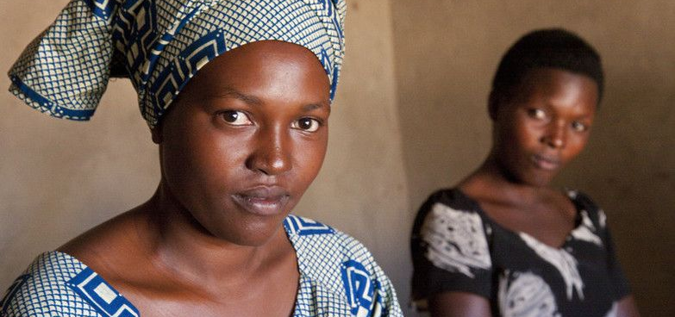
Leaving no one behind: how do IFAD independent evaluations contribute?
Simona Somma, Evaluation Officer, IOE
Joint Conference RELAC-REDLACME-IDEAS
Guanajuato, 6 December 2017

Slide 2
IFAD in the context of the Sustainable Development Agenda
IFAD’s Mandate – to reduce rural poverty through investments in agriculture and rural development
IFAD 2016-2025 Strategic Framework: targeting is a principle of engagement
IFAD Policy on Targeting (2006):
IFAD’s target group: rural people living in poverty and food insecurity in developing countries. Reach the extremely poor people.
Targeting methods: geographic, self and direct
Notes:
Agenda 2030 has an ambitious and bold transformational vision for the next 15 years and the centrality of agriculture and rural development in the global agenda and the role that smallholder farmers have as active drivers of development underline the relevance and importance of IFAD’s mandate and provides a key reference for its policies, priorities, and development interventions.
the foundation being the principle that “no one will be left behind and those furthest behind must be reached first”. it is no coincidence that targeting is one of the core IFAD’s principles of engagement in delivering on its mandate of rural poverty reduction.
The principles of engagement lie at the core of IFAD’s identity, values and institutional DNA and cut across the delivery of all its development results. IFAD-supported programmes will consistently aim to target and benefit the largest number of poor rural people possible thus ensuring that no one is left behind, empower them socially and economically, and promote gender equality. IFAD will place a premium on innovation, learning and scaling up of successes and, in the process, leverage effective and efficient partnerships.
IFAD also has a policy on targeting dated 2006 which defines IFAD’s target group: rural people living in poverty and food insecurity in developing countries. Within this broad group, IFAD strives to reach the extremely poor people. The policy also articulates the principles, methods and operational guidelines for targeting poor rural people and vulnerable groups approach. The policy is the reference document for the assessment of targeting by independent evaluations at IFAD.
The next slides will provide you with an overview of how the assessment is conducted and how and why independent evaluations play an important role in ensuring that no on is left behind.
Geographic targeting. focusing on geographic areas with high concentrations of poor people or with high poverty rates is an effective targeting instrument. In these cases,
IFAD uses national poverty lines and data on food insecurity and malnutrition – including data generated by FAO and WFP – combined with other human development data, to identify
disadvantaged areas.
Self-targeting measures. Success depends primarily on whether development activities have been designed with the poor themselves, around their needs and livelihood constraints,
and are perceived by them as relevant and affordable. Self-targeting is achieved by providing services that respond specifically to the priorities, assets and labour capacity of the
identified target group, while being of less interest to the better-off.
Direct targeting. When services are to be channelled to specific individuals or households, eligibility criteria have to be used.

Slide 3
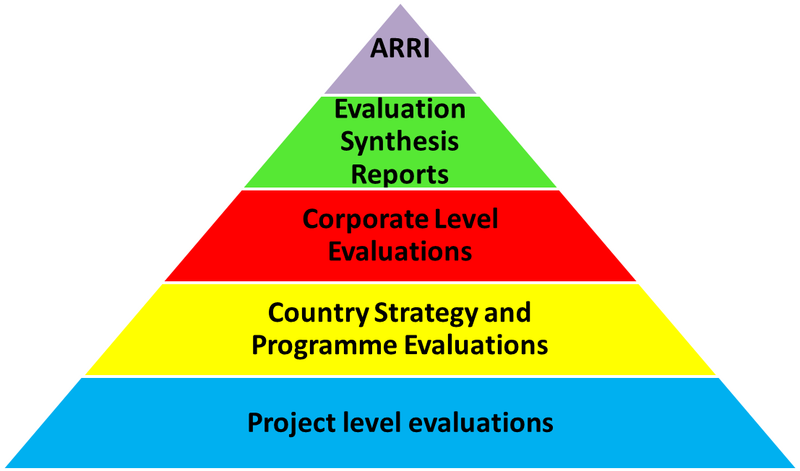
How do IFAD independent evaluations contribute to leaving no one behind?
Document when and where vulnerable groups are left behind. Relevance and effectiveness of targeting assessed in all evaluation products (mix-methods)
Notes:
the main purpose of the ARRI is to provide an aggregated insight into the performance of IFAD operations and identify systemic issues and lessons, as well as generate recommendations to enhance IFAD’s development effectiveness.

Slide 4
How do IFAD independent evaluations contribute to leaving no one behind? (cont.)
Explain why they are left behind;
Provide lessons and recommendations on how to improve and what to do, so that they are not left behind.
IFAD’s Management Response System:
President’s Report on the Implementation Status of Evaluation Recommendations and Management Actions (PRISMA)
Notes:
recommendations that strengthen the organization’s accountability framework and learning loops for enhanced rural transformation and better livelihoods.
IOE’s evaluation approach aims to transform each evaluation into a systematic learning exercise, therefore evaluations do not merely finish with a publication, but with an understanding among partners to adopt specific findings and recommendations. With this objective, at the completion of an evaluation, a Management’s response or an ACP is prepared. As required by the IFAD Evaluation Policy, the status of the adoption of the recommendations is reported through the PRISMA which contains an account of the follow-up actions taken by Management and government on the recommendations made in the ARRI, CLEs, CSPEs, PPEs and evaluation synthesis reports.
Efforts are made to ensure that appropriate feedback loops are established and learning opportunities developed so that findings and conclusions from evaluations feed into ongoing work. The next slides will show how this happens in practice.

Slide 5
Lessons from selected IFAD independent evaluations: why are vulnerable groups left behind?
Evaluation Synthesis Reports on Youth, IPs, Pastoralists, Gender:
Weak poverty analyses: differences among groups of rural poor are not captured. Scope for better tailoring of targeting approaches;
Weak M&E systems: data quality and timeliness. Disaggregated indicators to track the participation and benefits for different groups;
Specific knowledge and specialised experience not always available.
Notes:
Let me start with the first key question: why? The Key findings from ESR that IOE has conducted on different vulnerable groups
Weak M&E system that do not provide data on targeting of the quality that is needed and when they are needed

Slide 6
Lessons from selected IFAD independent evaluation: why are vulnerable groups left behind? (cont.)
Activities often do not reach all target beneficiaries
CSPE-Peru:
Targeting at design: geographic and self-targeting
CSPE results:
Geographic targeting relevant and effective
Targeting of the most vulnerable within these communities was less effective
Why? “Barriers at entry” at design which excluded the participation of the poorest (youth/women without land and financial resources)

Slide 7
Selected recommendations from IFAD independent evaluation: what to do and how to ensure that vulnerable groups are not left behind?
Recommendations | Follow-up actions (PRISMA)
Greater attention to key design elements towards better targeting strategies | Project design includes social assessment and institutional and governance assessment Designs targeting pastoralists and drylands are including analysis of risks Modification of barriers at entry How-to-notes
Enhanced understanding of IPs issues by project staff | Training for project staff on identity and socio-cultural characteristics of different IPs. Hiring project staff with knowledge on IPs issues and local languages. Delivering training for beneficiaries in local languages.
Systematic M&E of disaggregated benefits and Gender outcomes at corporate and project levels. | Corporate performance indicators; sex-disaggregation of indicators at individual and head of the household level.
Notes:
Corporate performance indicators to capture progress against gender policy objectives; sex-disaggregation of indicators at individual and head of the household level.
Evaluation synthesis reports are very different from other IOE products, as they are prepared to primarily promote learning, collective reflection and improve IFAD’s development effectiveness. The report is a knowledge product that aim to enhance the general understanding of a particular topic, to consolidate and share acquired knowledge and strengthen IFAD’s evaluation feedback and learning loops.

Slide 8
Conclusions
Focus on “no one left behind” – requires enhanced strategies for targeting & outreach, M&E, and capacities to implement them.
Independent evaluations – key to assess and present evidence on whether an operation reached vulnerable groups; to stimulate learning, follow up on recommendations and improve.

