Slide 1
ICT for Evaluation Société Luxembourgeoise d’évaluation et de prospective
Oscar A. Garcia
Director
Independent Office of Evaluation IFAD

Slide 2
Context
4th industrial revolution
Demographic explosion
Climate change
Increasing disparities
SDGs: people, planet, prosperity, peace, partnerships

Slide 3
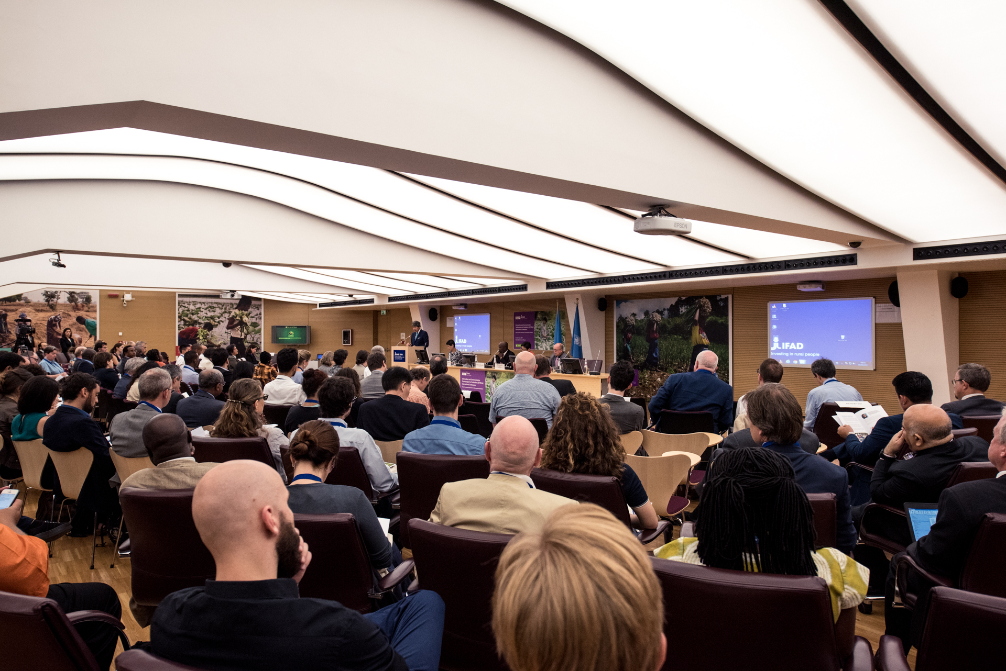
ICT4Eval Conference 6 – 7 June 2017
200 participants, including UNEG, ECG, private sector, academic institutions, NGOs, think tanks and national-level counterparts

Slide 4
SDGs and Challenges for evaluators
145 out of 232 indicators of SDGs cannot be measured as of today (UNDP Guidance note, September 2017)
What can be measured is a result traditional approaches to:
Data collection
Data analysis
Dissemination of evaluation results

Slide 5
Technology and new data
Newer avenues and sources of data – e.g. Remote sensing
Better analysis of existing data – e.g. Machine learning and big data analytics
Better Feedback loops to stakeholders, especially beneficiaries in the field

Slide 6
Examples of frontrunners
Save the Children, Somalia -> Conflict and lack of mobility -> Use of satellite data for infrastructure, Skype and email for remote audits and verification -> Possibility of evaluations in midst of deteriorating security environment
GEF-IEO and DEval -> Evaluations -> Lack of counterfactual for environment impacts -> Remote Sensing -> Readily available impact and counterfactual for low cost combined with other sources
3ie -> Systematic reviews -> Time and labour consuming review process -> Machine learning -> Reducing review time by up to 70%
Oxfam GB -> Impact evaluations in Zambia and Thailand -> Lack of feedback to beneficiaries -> Mobile phones for data collection and dissemination -> Real time feedback to beneficiaries and validation of impact data collected

Slide 7
Results
Increased effectiveness and efficiency
Better
Faster
Cheaper
Augmented bias
Disproportionally available (political economy)

Slide 8
Reflections for the future
Technology not a panacea but means to an end
Evaluations need to be grounded in theory
Ethics of paramount importance
Evaluation needs to remain human centric
Partnerships – Tapping into complementary capacities

