Slide 1

Conducing Impact Evaluation in Difficult Contexts using Geo-spatial and other Techniques:
Impact Evaluation in Georgia
October 3, 2018
Hansdeep Khaira
Evaluation Officer
IFAD’s Independent Office of Evaluation
Dustin Gilbreath
Deputy Research Director
CRRC-Georgia
dustin@crrccenters.org

Slide 2
Organization of the talk
Country context
The Agricultural Support Project
Uses of Geo-spatial data within the evaluation
Lessons learned, potential extensions, and future work

Slide 3
Georgia: Country context
2 wars of secession in 1990-1991
Civil war in 1990-1991
August 2008 war (breaks out in South Ossetia, extends to Abkhazia)
~250,000 internally displaced people (~7% of population)
Right of return not happening, and slow moving ethnic cleansing particularly in Abkhazia.
Quasi-frozen conflict, however people on the administrative boundary line face regular issues (e.g. abductions, cattle theft, and a moving boundary line).

Slide 4
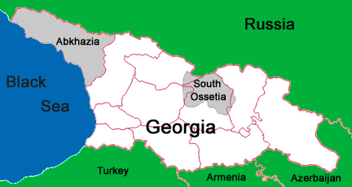

Slide 5
Agricultural Support Project
Challenges of undertaking evaluation in the country context
- Restricted mobility in some areas of the country (occupied areas)
Data limitations
Solution
Geospatial analysis
  Sampling
  Analysis

Slide 6
Agricultural Support Project
Developmental objectives
Increase assets & incomes among rural poor.
Remove infrastructural bottlenecks.
Project interventions
Rehabilitation of irrigation canals
Bridges for livestock movement
Drinking water infrastructure
Leasing products for agricultural businesses

Slide 7
Objective and approach of evaluation
Objective of impact evaluation
Measure the economic changes in the lives of project beneficiaries using inter alia income and changes in agricultural production as indicators
Approach
Ex-post quasi-experimental method

Slide 8
Use of geospatial data for sampling
  Challenge
  No random assignment of treatments at the individual or cluster level;
  Lack of adequate baseline data.
  Solution: Match on cluster level demographic and geo-spatial characteristics for the infrastructure component, prior to intervention:
      NDVI
      Gender balance of adults in communities
      Ethnic minority community
      Adult population size
      Average elevation
      Distance to a primary road
      Distance to a secondary road
      Distance to a tertiary road
      Distance from a regional center
      Area of the district
      Koppen climate classification
      Population density
      Propensity scores

Slide 9
Use of geospatial data for sampling
Comparison of cluster level balance with matched versus random selection of control clusters:
  Minimum p-value:
    Random sample: p= 0.004107**
    Matched sample: p=0.14894
  Number of significant differences at cluster (community) level:
    Random sample: 3 variables (6 tests)
    Matched sample: 0

Slide 10
Topline survey results
Irrigation communities→ Increased amount of irrigated land, but no increase in agricultural incomes.
Bridge communities → Null results all around.
Drinking water communities → Slight decrease in amount of time getting drinking water, but other wise null results.
Leasing indirect beneficiaries → Statistically and substantively significant increases in agricultural incomes.

Slide 11
Use of geospatial data for analysis
  NDVI
  To estimate magnitude & significance of difference in vegetation development (NDVI) based on temporal variations (project baseline 2013 and endline 2016)
  The rationale is that project interventions will cause a different pattern of change from before to after the treatment compared with similar areas not treated by the project.

Slide 12
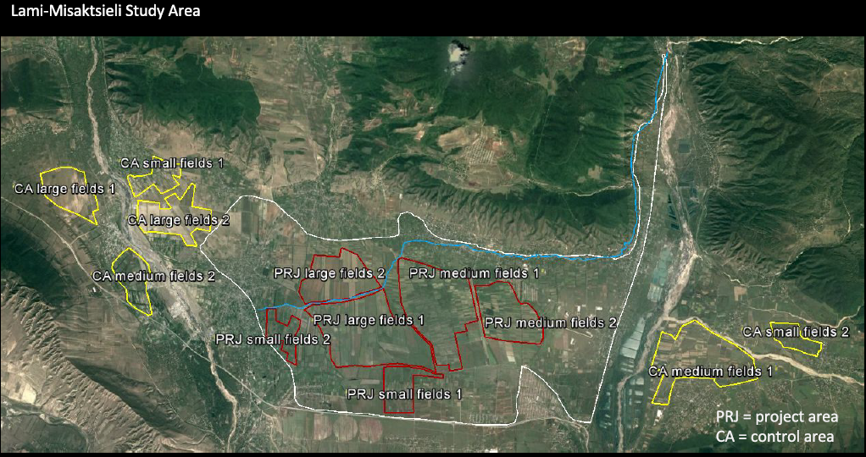

Slide 13
Use of geospatial analysis
The methodology applied is derived from the “Before/After Control/Impact ‘BACI’ contrast presented in a recent research paper.
Data: Analysis performed using 250-m NASA MODIS NDVI product (8 days) from 2004 to 2016 (Landsat on going)
Project Area: Five irrigation schemes that were rehabilitated as part of project intervention. Farm plots split into three sizes: small (< 2ha), medium (2-10ha) large (> 10ha) - to understand better the effect on different types of farmers.
Selection of non-treated sites based on:
    similar land cover
    geographic proximity
    not subjected to intervention
    randomly selected

Slide 14
Use of geospatial analysis
  The impact of the intervention is evaluated by the change between T and NT before and after the intervention.
BACI contrast = ( µNT_{a} − µNT_{b} ) − ( µT_{a} − µT_{b} )
where µ is the site-specific spatial NDVI mean; NT_{a}, T_{a} stand respectively for non-treated area and treated area at endline (after); NT_{b} and T_{b} stand respectively for non-treated area and treated area at baseline (before).
  By convention, a negative BACI contrast indicates that the variable has increased more in the intervention site with respect to controls in the time period before and after intervention.
  The BACI analysis provides two important statistics: the significance level (P-value) of the BACI effect test and the BACI contrast*.
  *The (null) hypothesis of no change was rejected at the conventional 5% significance level.

Slide 15
Use of geospatial analysis
Negative BACI contrasts (in bold)
Green background is used to highlight negative BACI contrasts that are significant at the 0.05 P-value
Light green background is used to highlight negative BACI contrasts that are very close to significant 0.05 P-value
Grey background indicates a non-significant/no BACI effect.

Slide 16
Results
Field mission
Results of ground-truthing carried out though a field mission confirmed the low uptake of irrigation in intervention areas.
Some of the increase in vegetation was due to more grass being grown (livestock fodder).
Impact Evaluation
Results of HH survey also showed statistically significant increase in land area available for irrigation but insignificant increase in area irrigated after intervention.

Slide 17
Uses of geo-spatial the project inspired for us, but we didn’t use
Multi-level models incorporating cluster level data
  More stable estimates, better controlled models
Synthetic controls applications of geo-spatial data

Slide 18
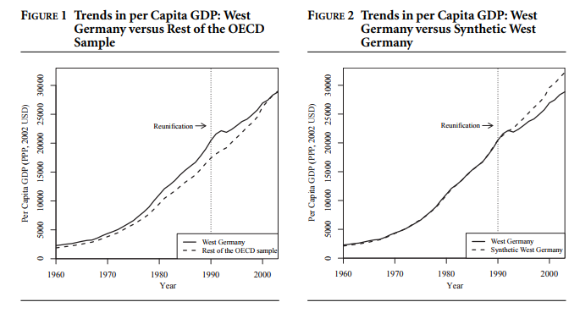
Some notes on synthetic controls using geo-spatial
What is a synthetic controls model and what do you need?
  (Abadie, Diamond, and Hainmueller, 2015)

Slide 19
Some notes on synthetic controls using geo-spatial
How could this model be used with geo-spatial data?
  Outcome variables a good geographer can get from a satellite or other geo-spatial means:
    Night lights (a reasonable proxy for income, though problems exist at the unit level)
    NDVI
    Many more that I’m not aware of, because I’m not a geographer
  Covariates that a good geographer can get from a satellite or other geo-spatial means:
    Distance from a primary, secondary, or tertiary road (access to markets);
    Altitude
    Climate classification
    Distance from a conflict line
    Distance from an international border

Slide 20
Some notes on synthetic controls using geo-spatial
  Other variables that you can often get in time series, but are not necessarily geo-spatial:
    Population (from a countries list of electoral precincts)
    Gender balance (if the country’s voter list is public)
    Education level (if the census is available at the cluster level)
    Ethnicity/language spoken (if the census is available at the cluster level)

Slide 21
Some notes on synthetic controls using geo-spatial
  What are the implications: Survey-less evaluation
    You can get a reasonable estimate of economic impact without doing a survey
    You can get a reasonable estimate of whether something happened or not without doing a survey
    You don’t necessarily have to be on the ground, potentially leading to quick, good enough impact evaluation;
    You can get access to hard to access places including conflict affected areas.
  Improvement on existing geo-spatial methods

Slide 22
Lessons learned, applications, and things we thought of afterwards that might be valuable for others
Improved control group selection through matched sampling using geo-spatial data rather than sampling a random control group in post-hoc, quasi-experimental settings
Multi-level modeling to control for environmental factors makes sense (more stable estimates, in an environment where estimation is difficult)
Synthetic controls modeling would be a step up over the hand selection of control groups in the BACI
Synthetic controls modeling generally deserves a great deal of additional attention with geo-spatial data, because it has the potential to remove the need to do on the ground surveys;

